Slide 1
The Sixth SEEDI Conference
Digitization of Cultural and Scientific Heritage
Zagreb, Republic of Croatia
18th – 20th May 2011

Slide 2

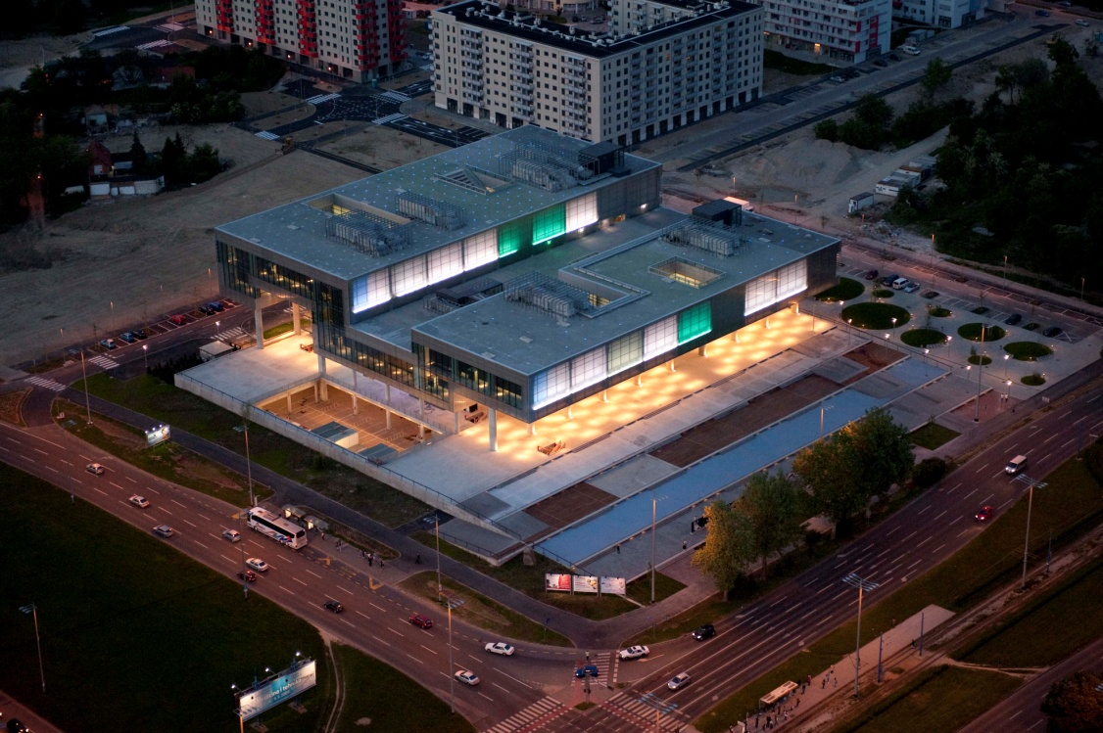
Museum of Contemporary Art Zagreb
DIGITALIZATION OF CONTEMPORARY ART

Slide 3
Processing the holdings

Slide 4
In 2000. MSU Zagreb started processing the holdings in the M++, a computer program that specializes in museums

Slide 5
In 2005. MSU Zagreb began a vast project of digitizing the museum materials

Slide 6
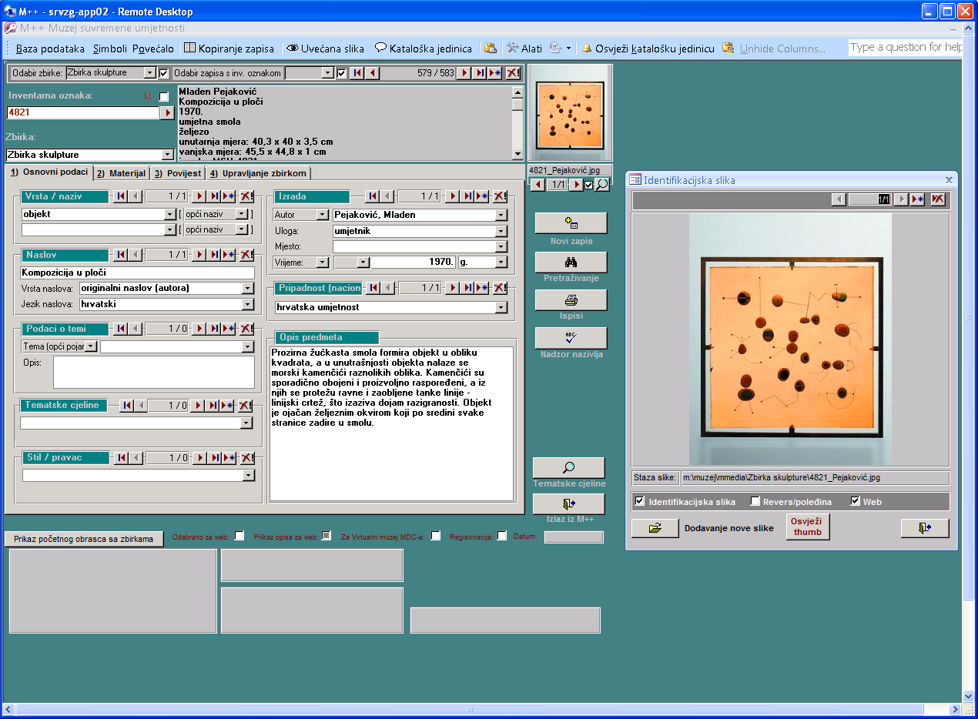

Slide 7
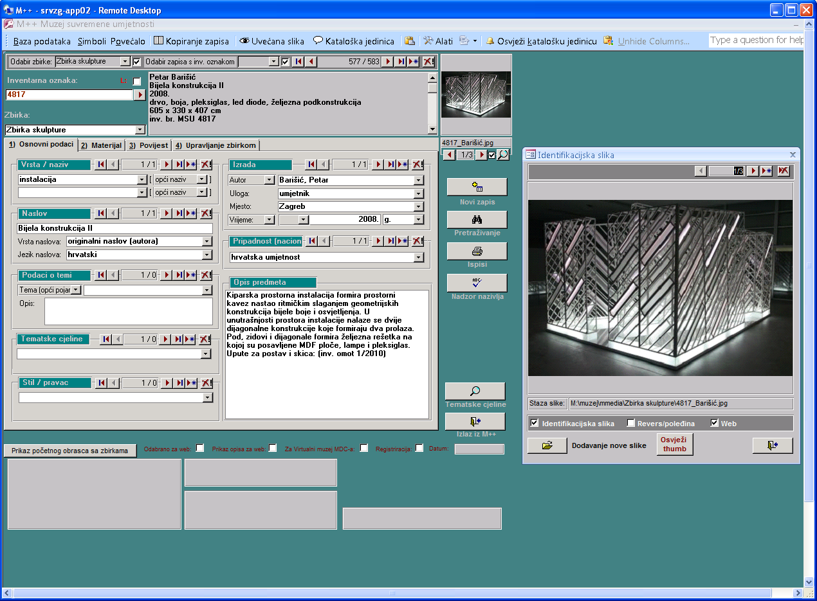

Slide 8
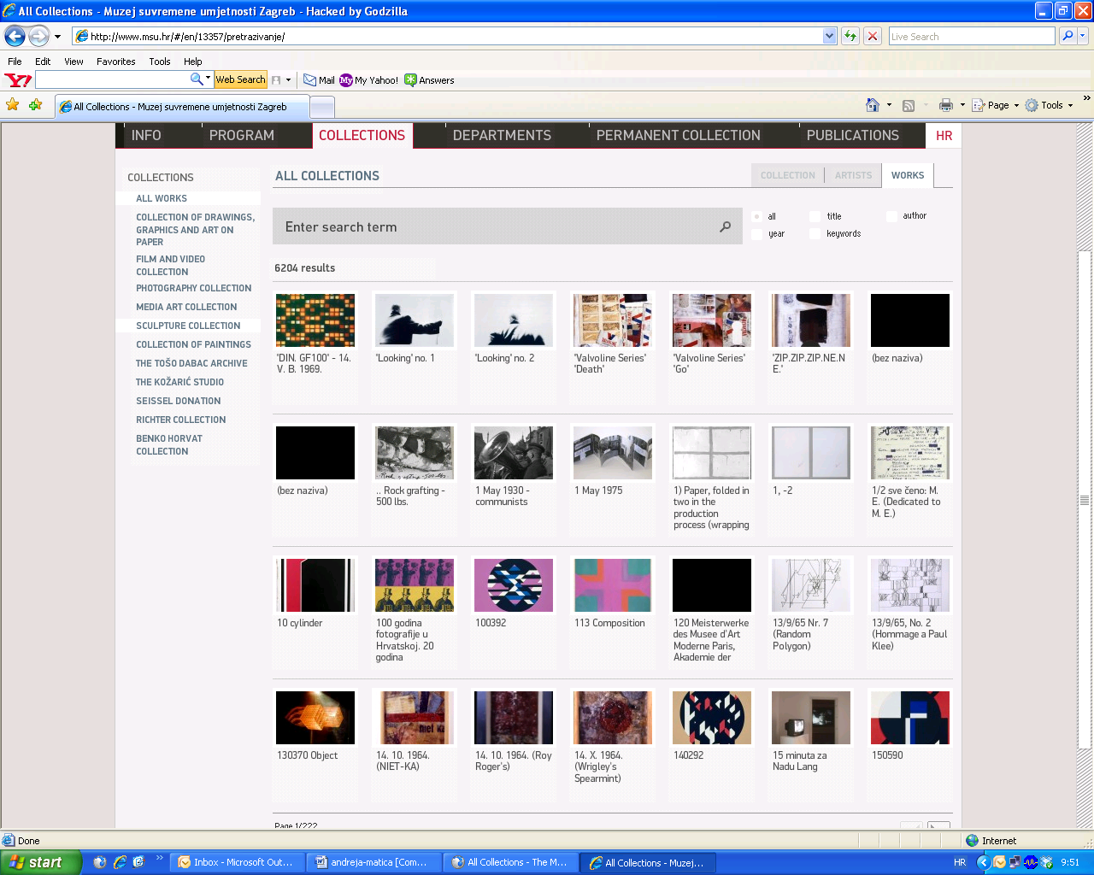

Slide 9
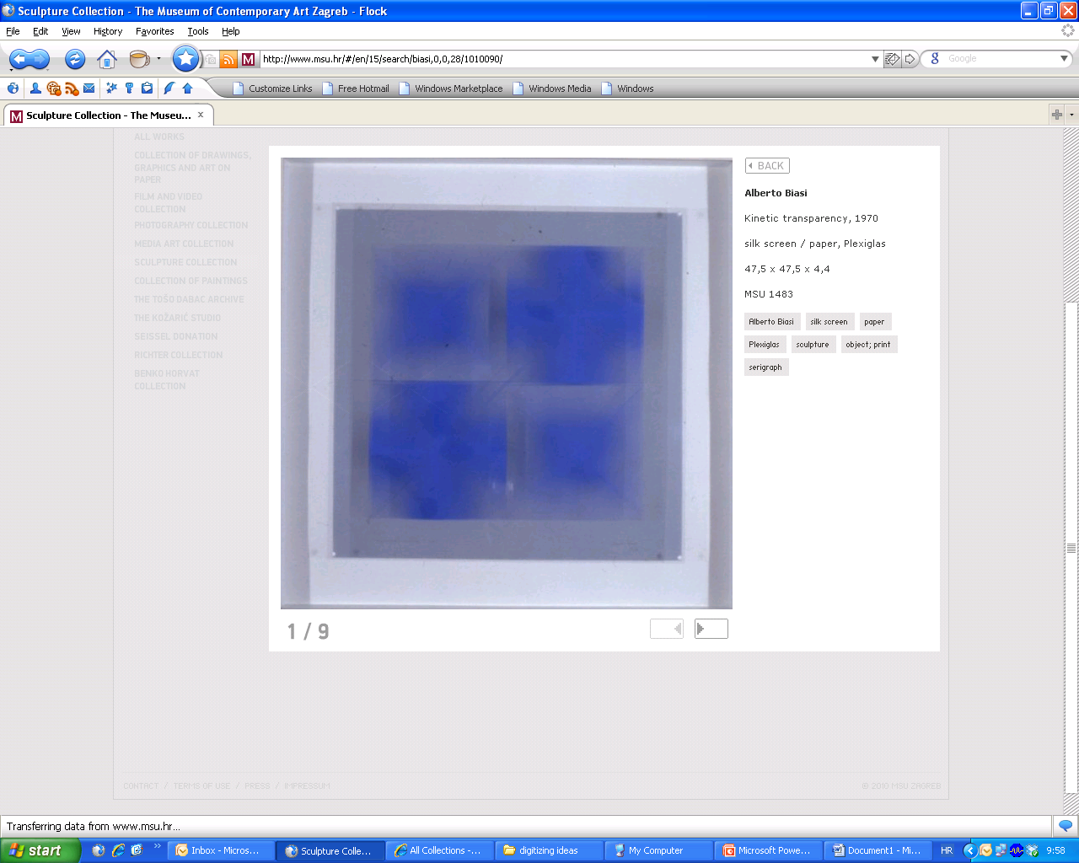

Slide 10
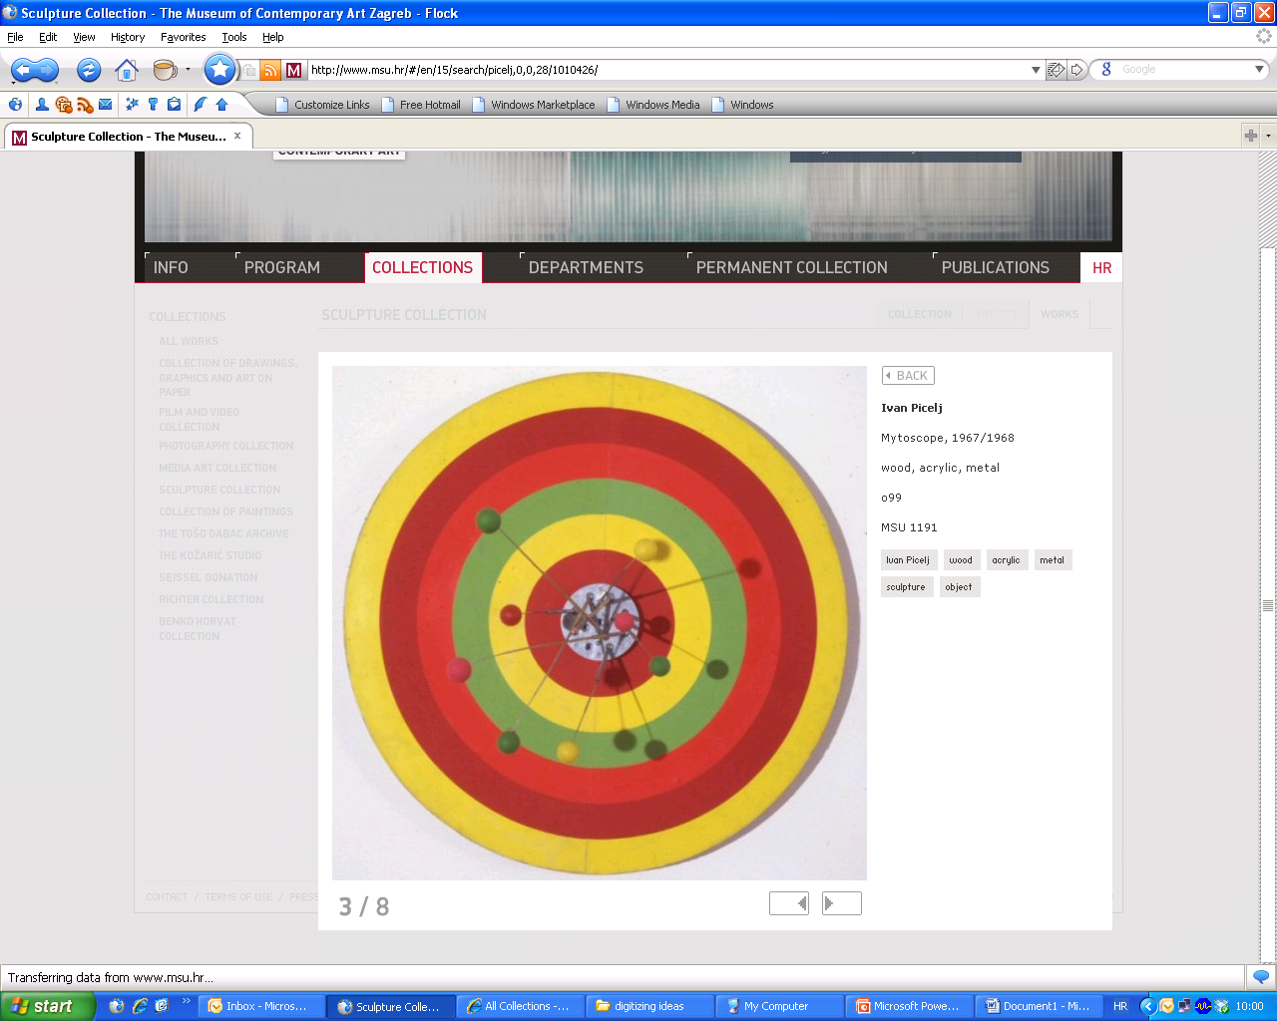

Slide 11
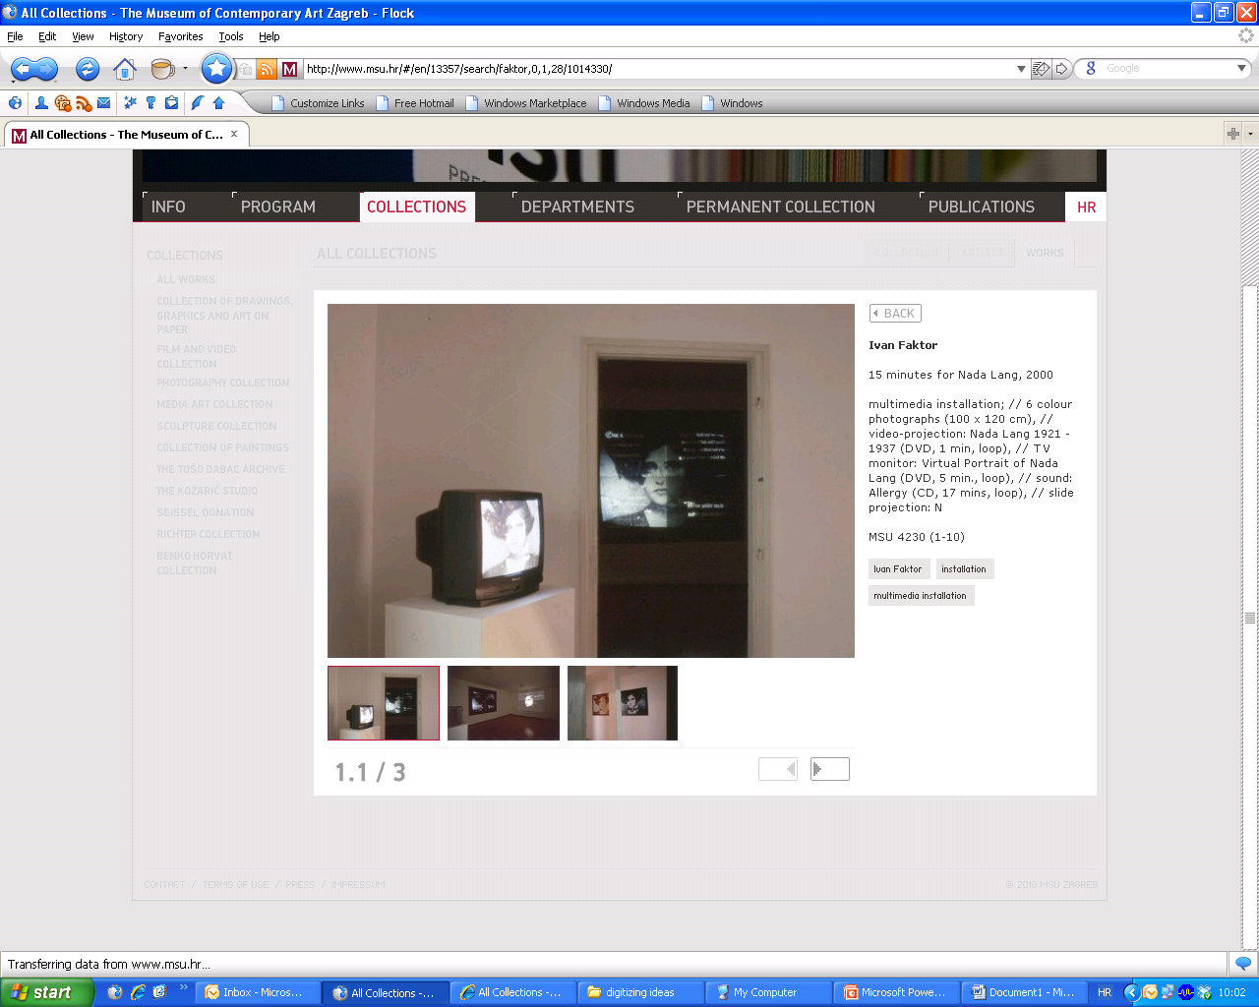

Slide 12
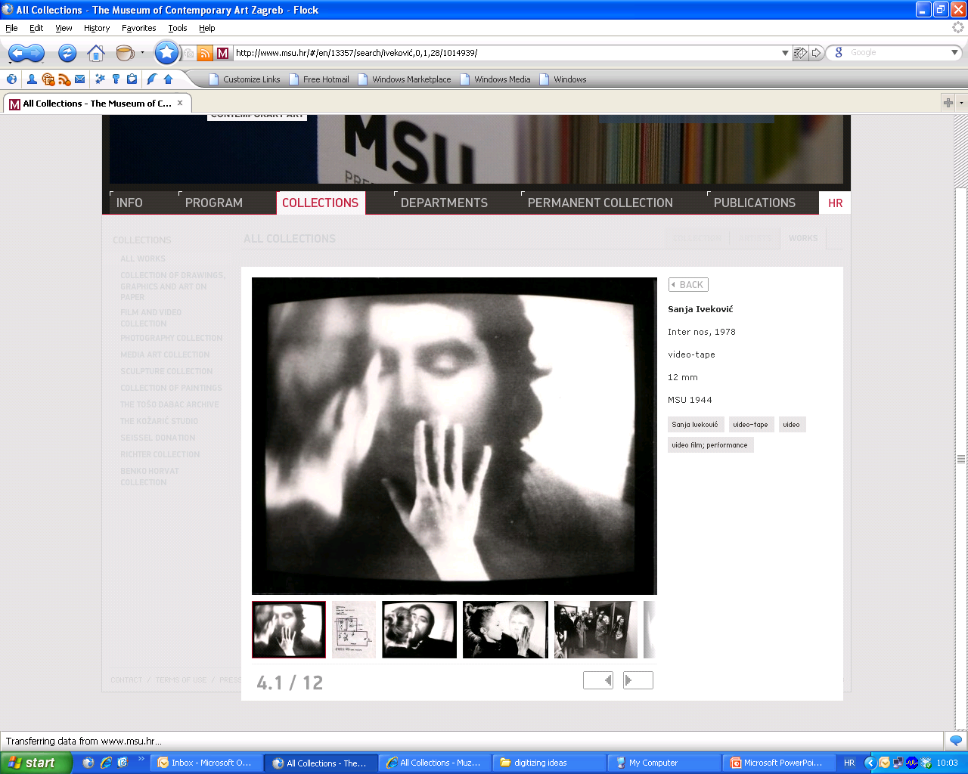

Slide 13
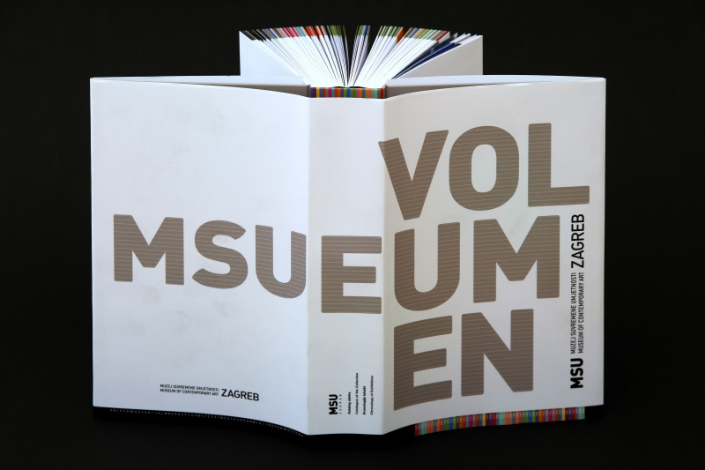
Catalogue “Volumen” - published by MSU in 2008 and praised by the experts in the field: the Association of Art Historians awarded us for promoting contemporary art.

Slide 14
web page http://www.msu.hr/

Slide 15
Information points (education points)- additional information on displayed artwork and authors.

Slide 16
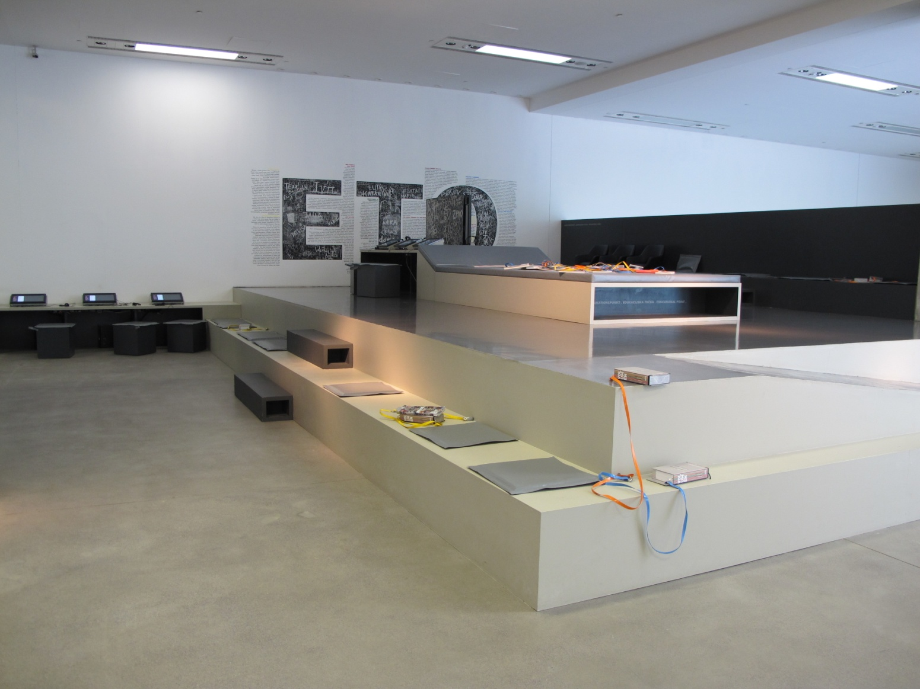

Slide 17
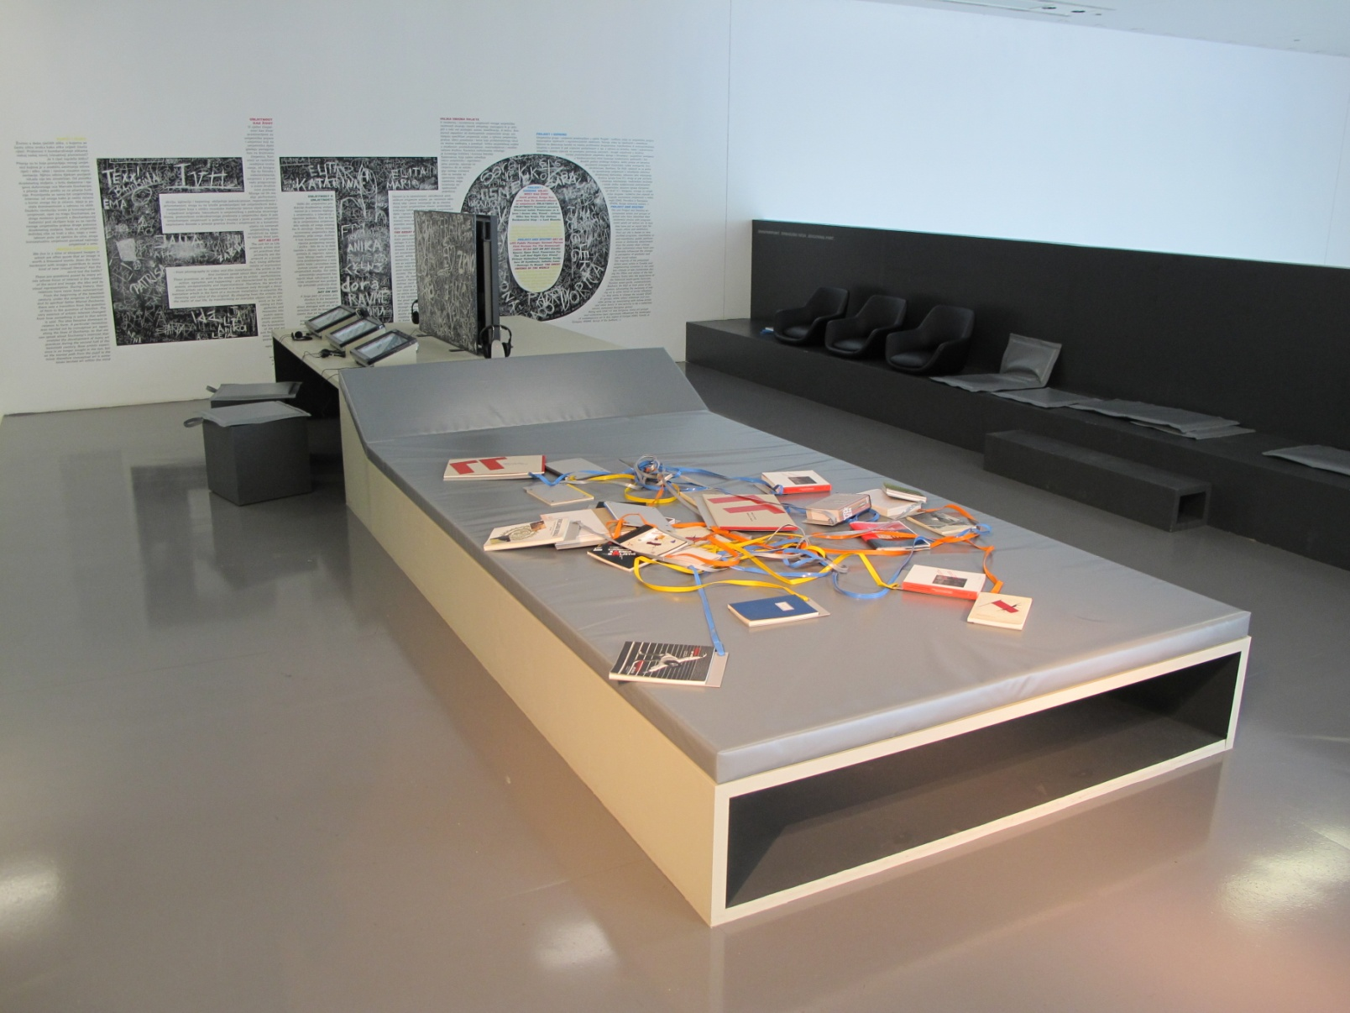

Slide 18
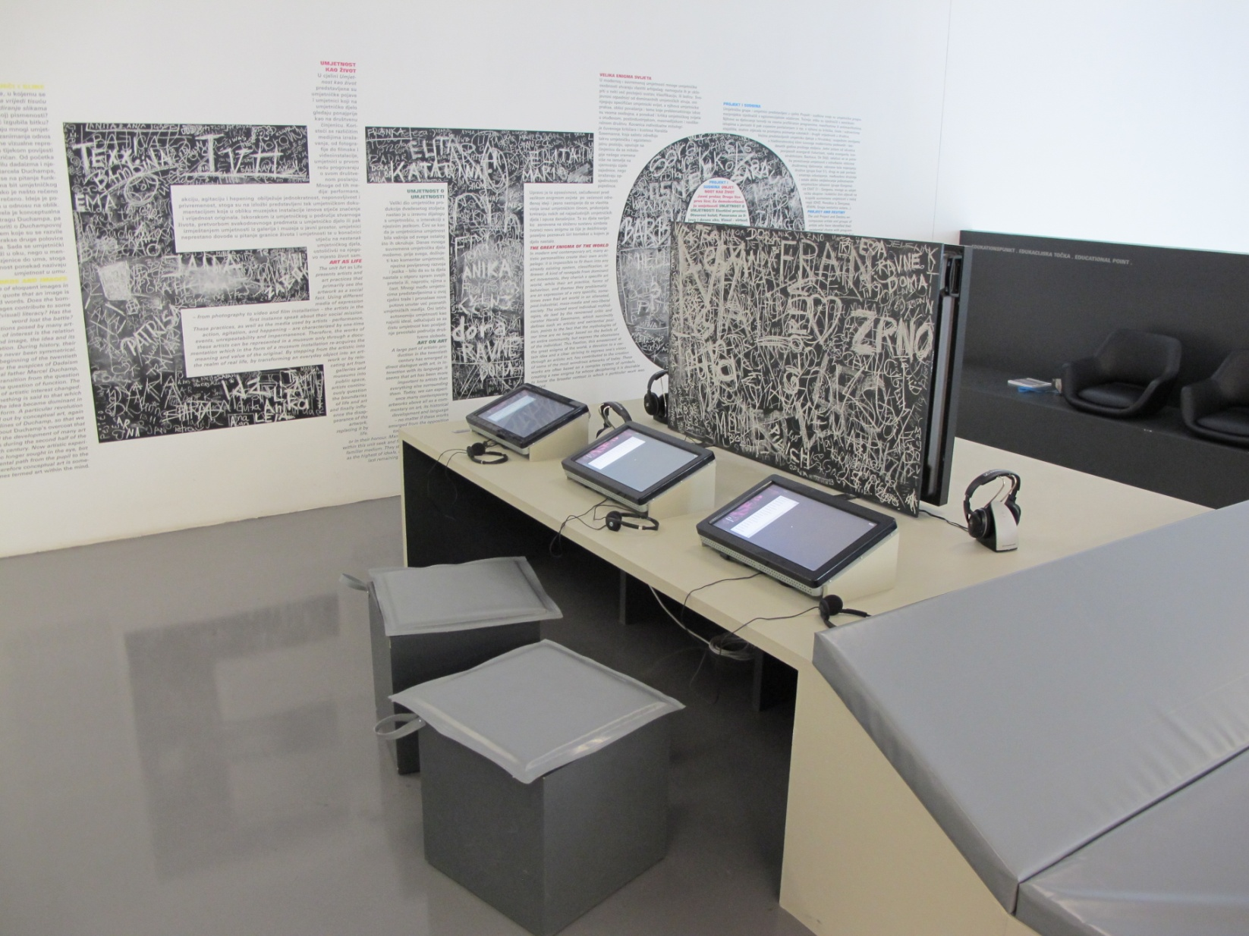

Slide 19
In 2010 the Collection Department of MSU applied for the tender by the Ministry of Culture for the national project called “Croatian Cultural Heritage”.

Slide 20
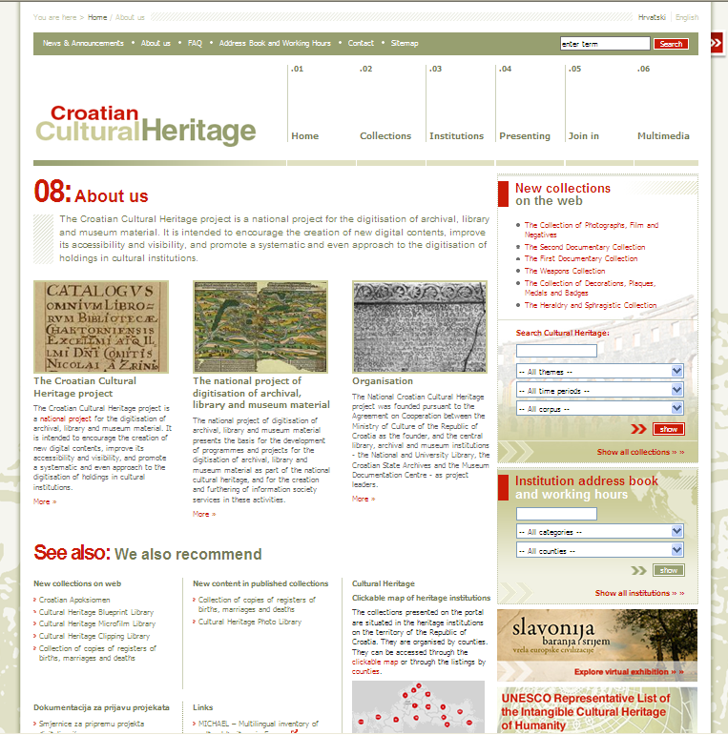

Slide 21
Expected effects:
- to secure the protection of the collections as cultural heritage of the Republic of Croatia, as well as digital content storage for the purposes of research and media presentation.
- increased number of users: both visitors of online collections and those who visit the permanent collection and information points. This will enable a wider access to information on works of art that the museum has been collecting for over half a century.

Slide 22


Digitizing ideas: ARCHIVES OF CONCEPTUAL ART PRACTICES
The project is initiated by the Museum of Contemporary Arts (Zagreb, Croatia)
Partners: Moderna Galerija (Ljubljana, Slovenia)
Museum of Contemporary Art Vojvodina (Novi Sad, Serbia)
Museum of Modern Art (Warsaw, Poland)

Slide 23
The aim of the project is to allow easier access to artworks and documentation about neo-avant-garde and conceptual art in Europe in 60s an 70s.

Slide 24

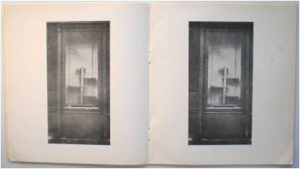
Gorgona 1, 1961. Vaništa Josip

Slide 25

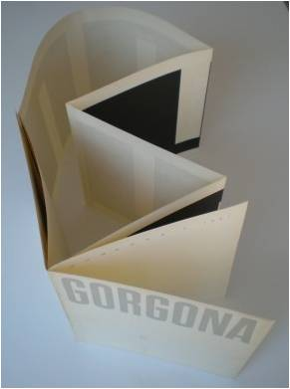
Gorgona 2, 1961. Knifer Julije

Slide 26

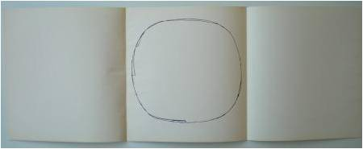
Gorgona 3, 1961. Jevšovar Marijan

Slide 27
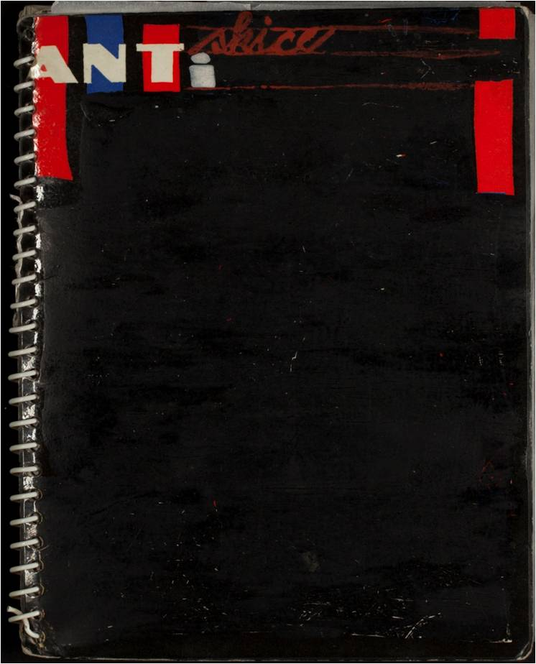
Antiskice, 1963. Bašičević Dimitrije Mangelos

Slide 28
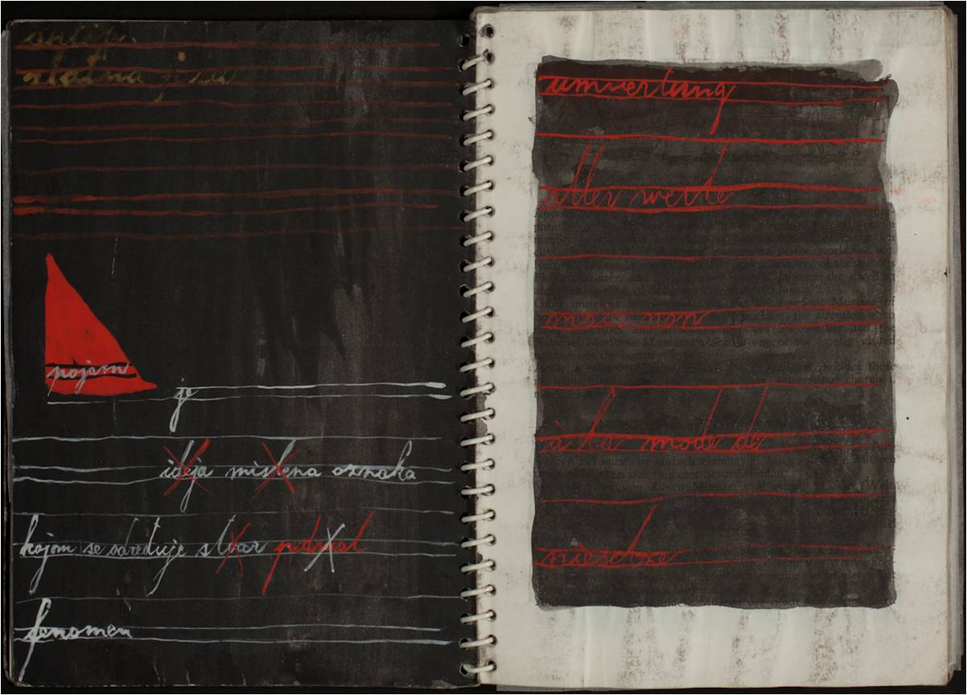
Antiskice, 1963. Bašičević Dimitrije Mangelos

Slide 29

Les payasages de tabula rasa, 1953. Bašičević Dimitrije Mangelos

Slide 30
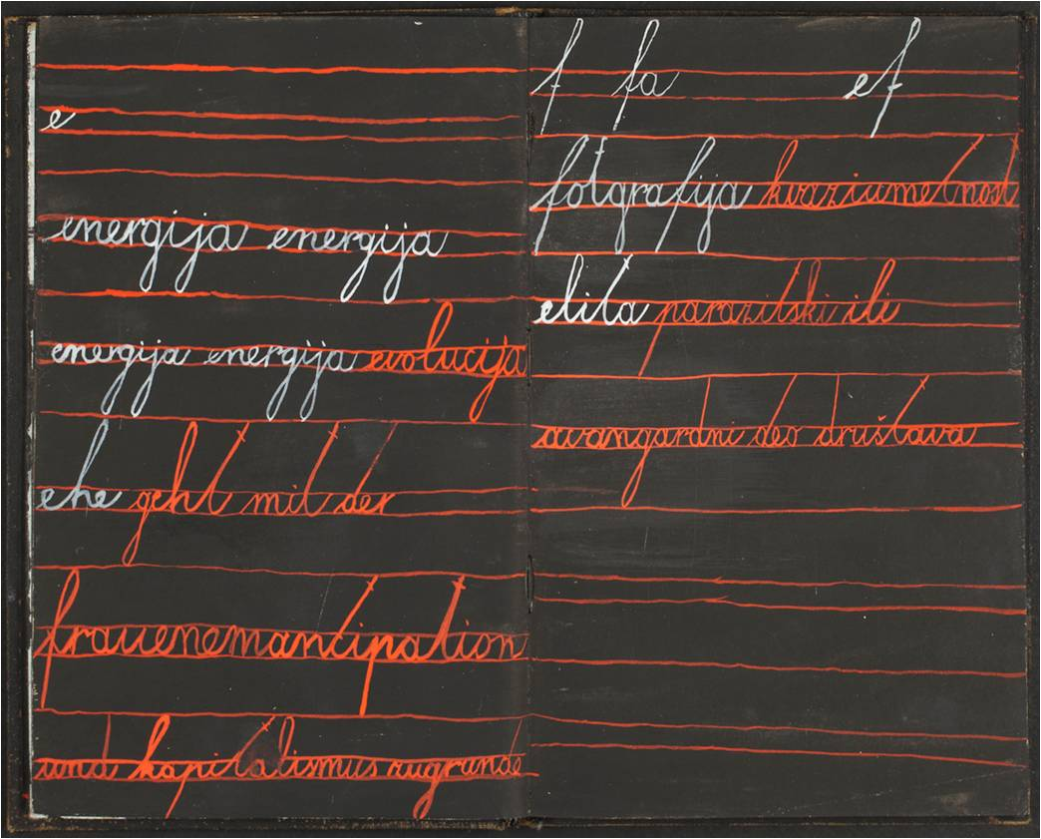
Les payasages de tabula rasa, 1953. Bašičević Dimitrije Mangelos

Slide 31

Nemam vremena, 1979. Stilinović Mladen

Slide 32
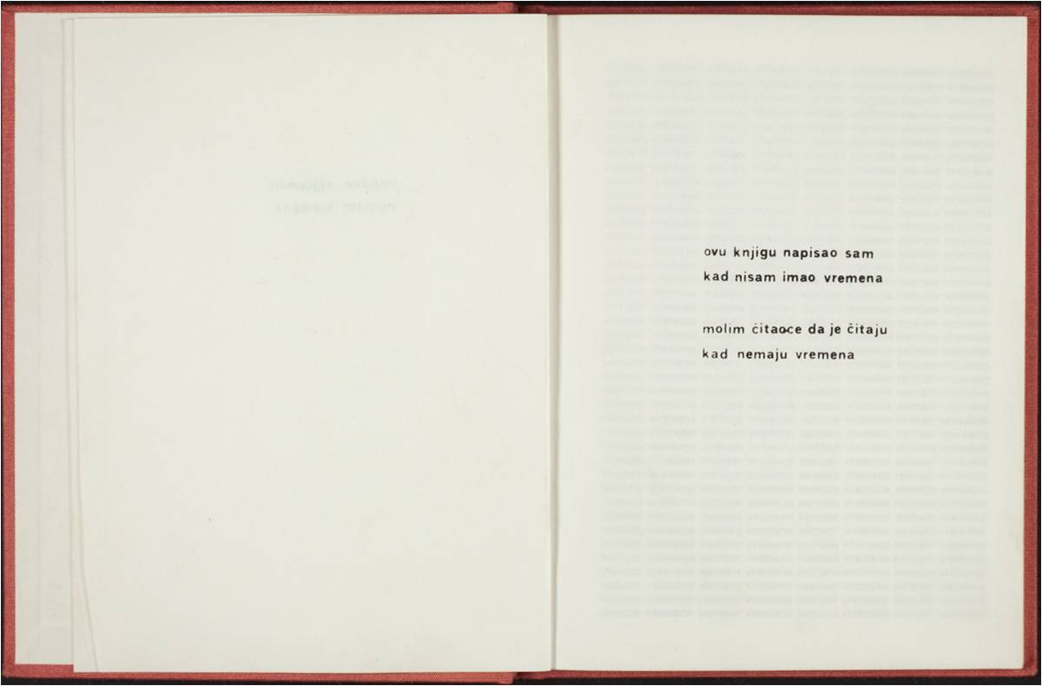
Nemam vremena, 1979. Stilinović Mladen

Slide 33
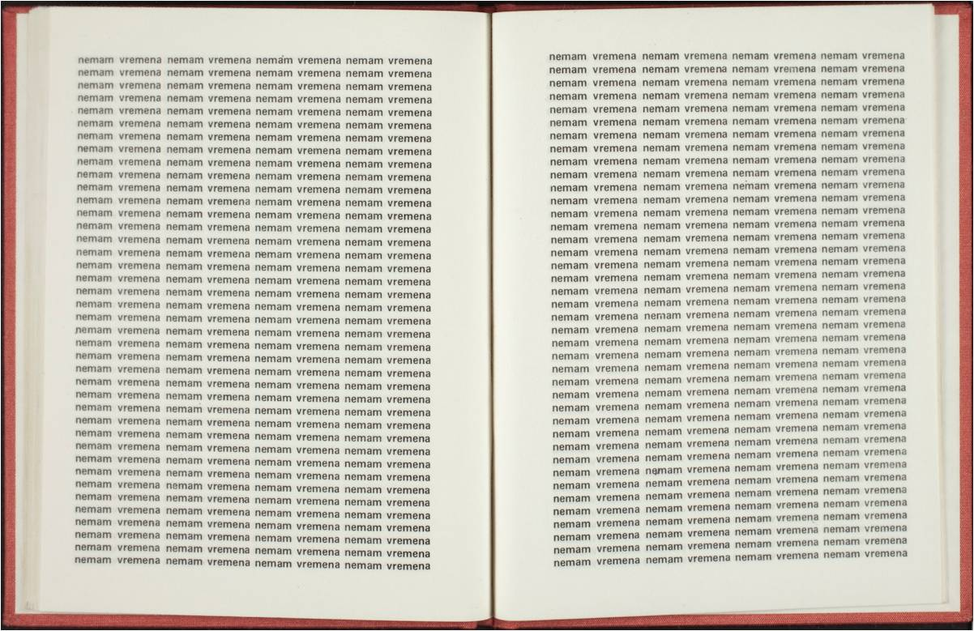
Nemam vremena, 1979. Stilinović Mladen

Slide 34
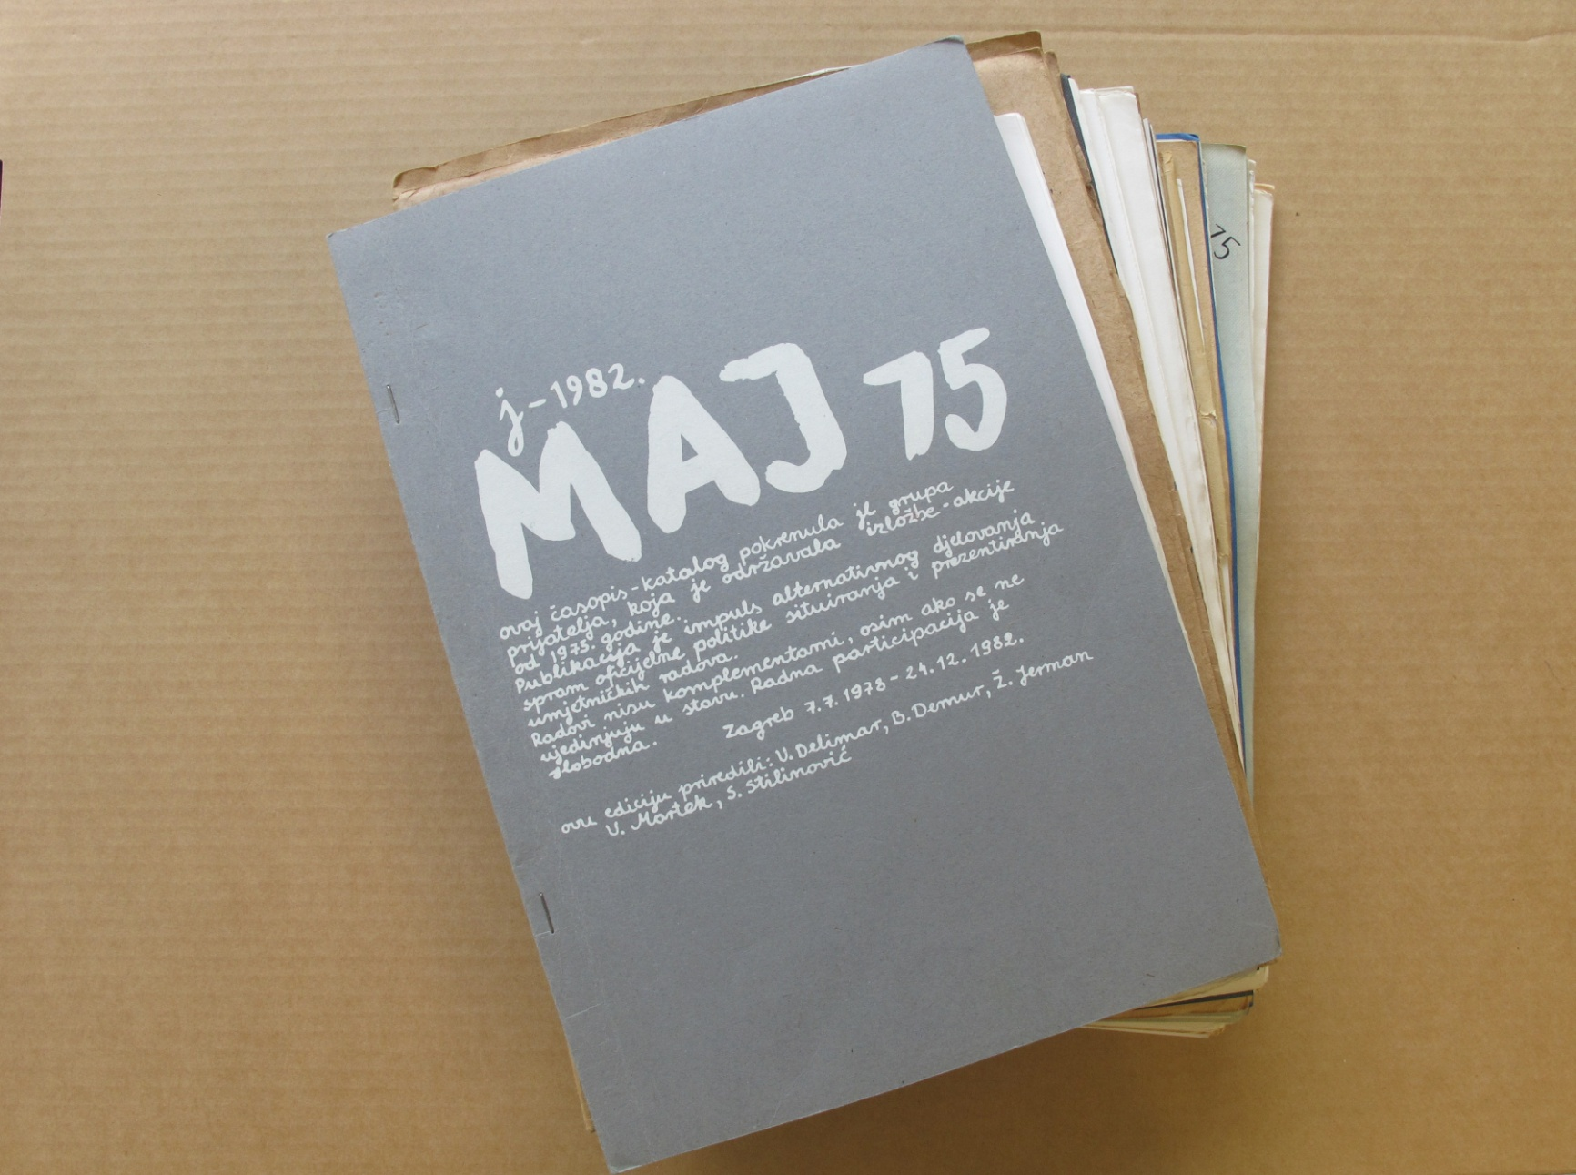
Maj 75

Slide 35
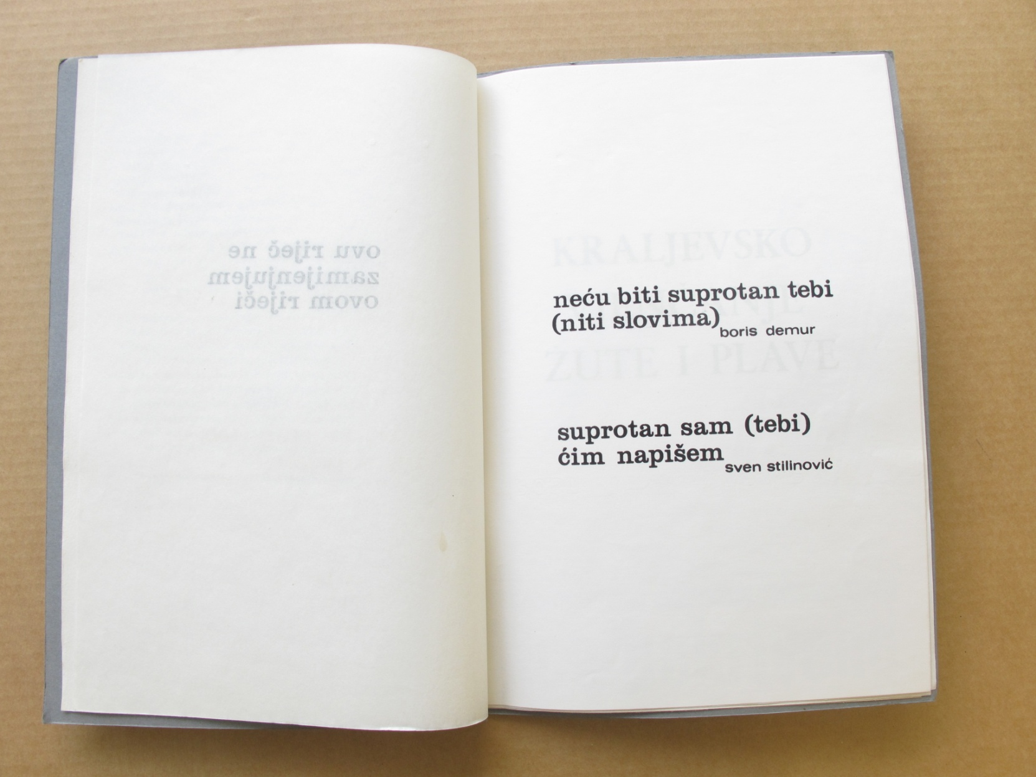
Maj 75

Slide 36
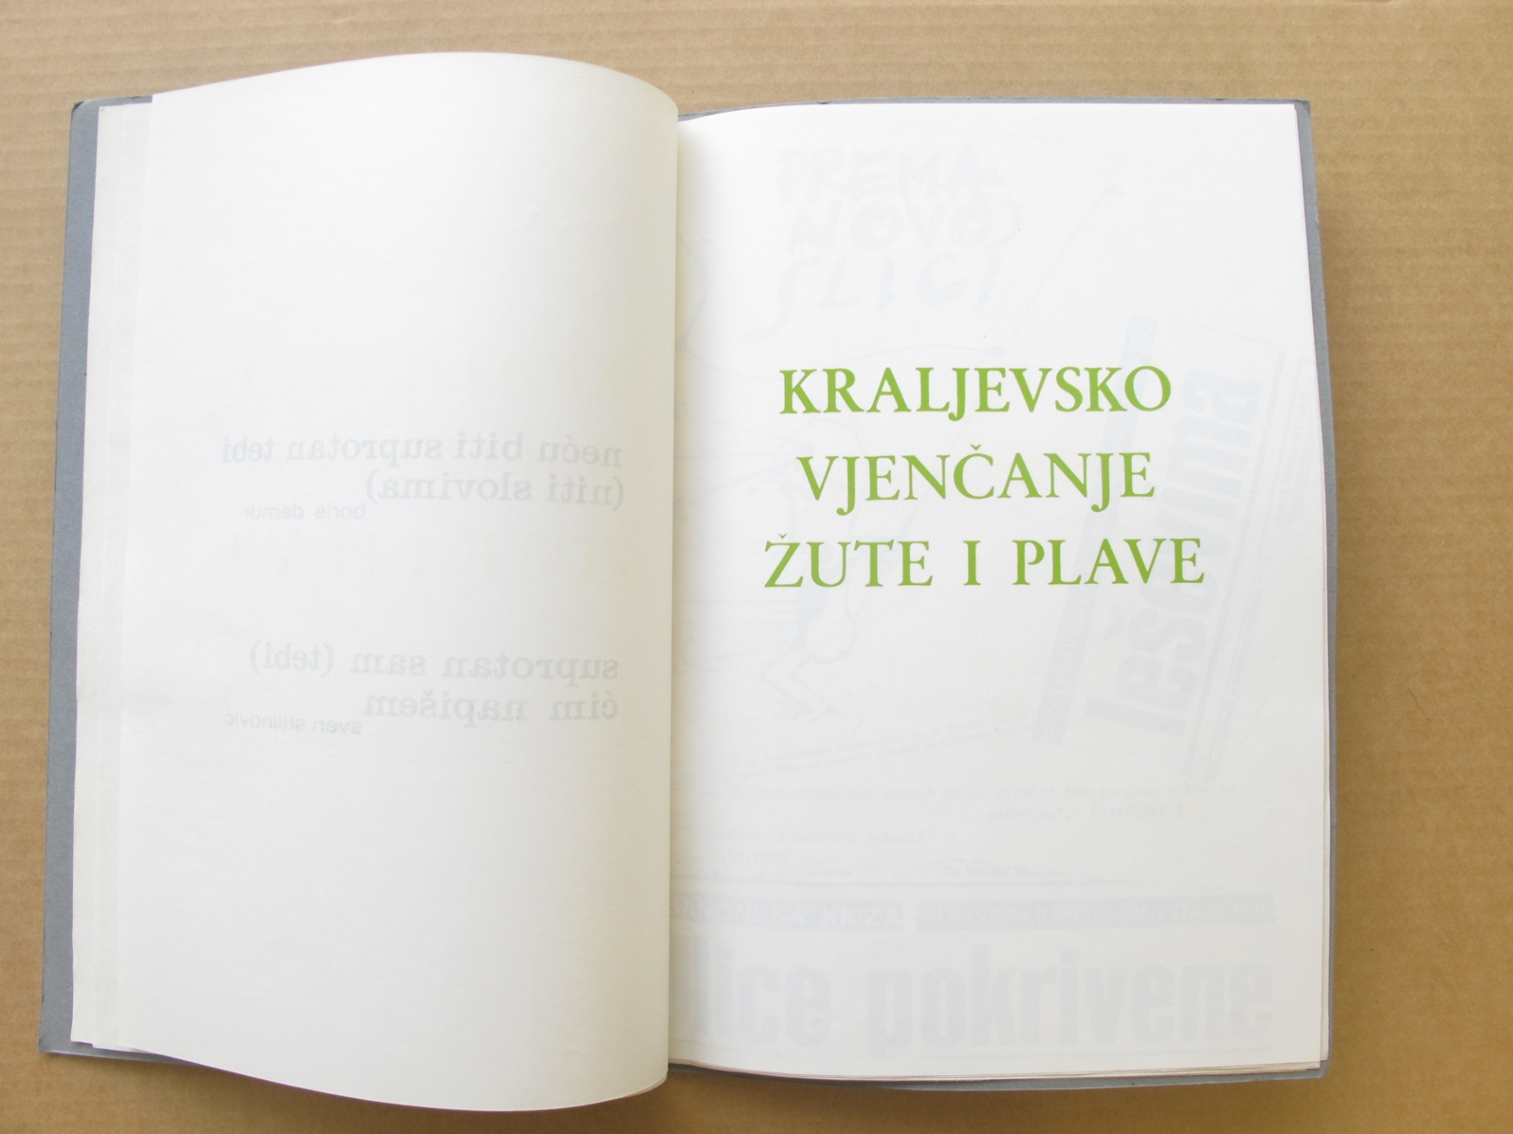
Maj 75

Slide 37
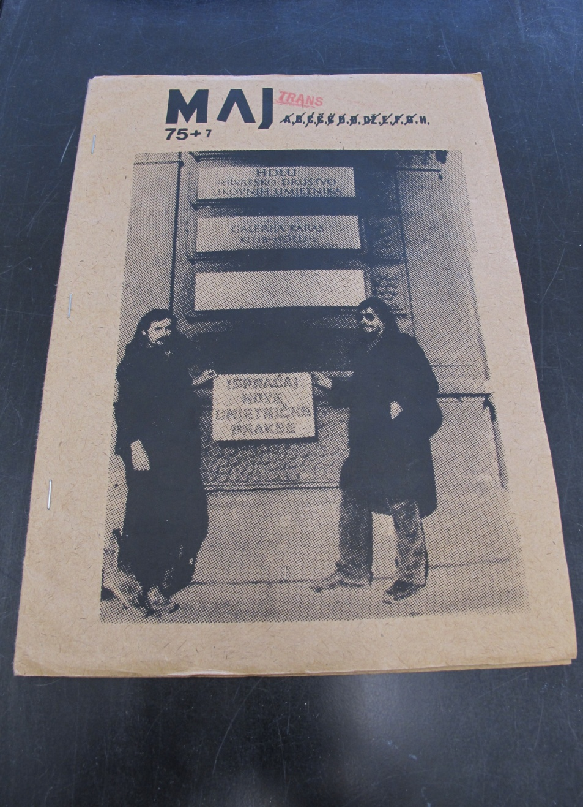
Maj 75

Slide 38
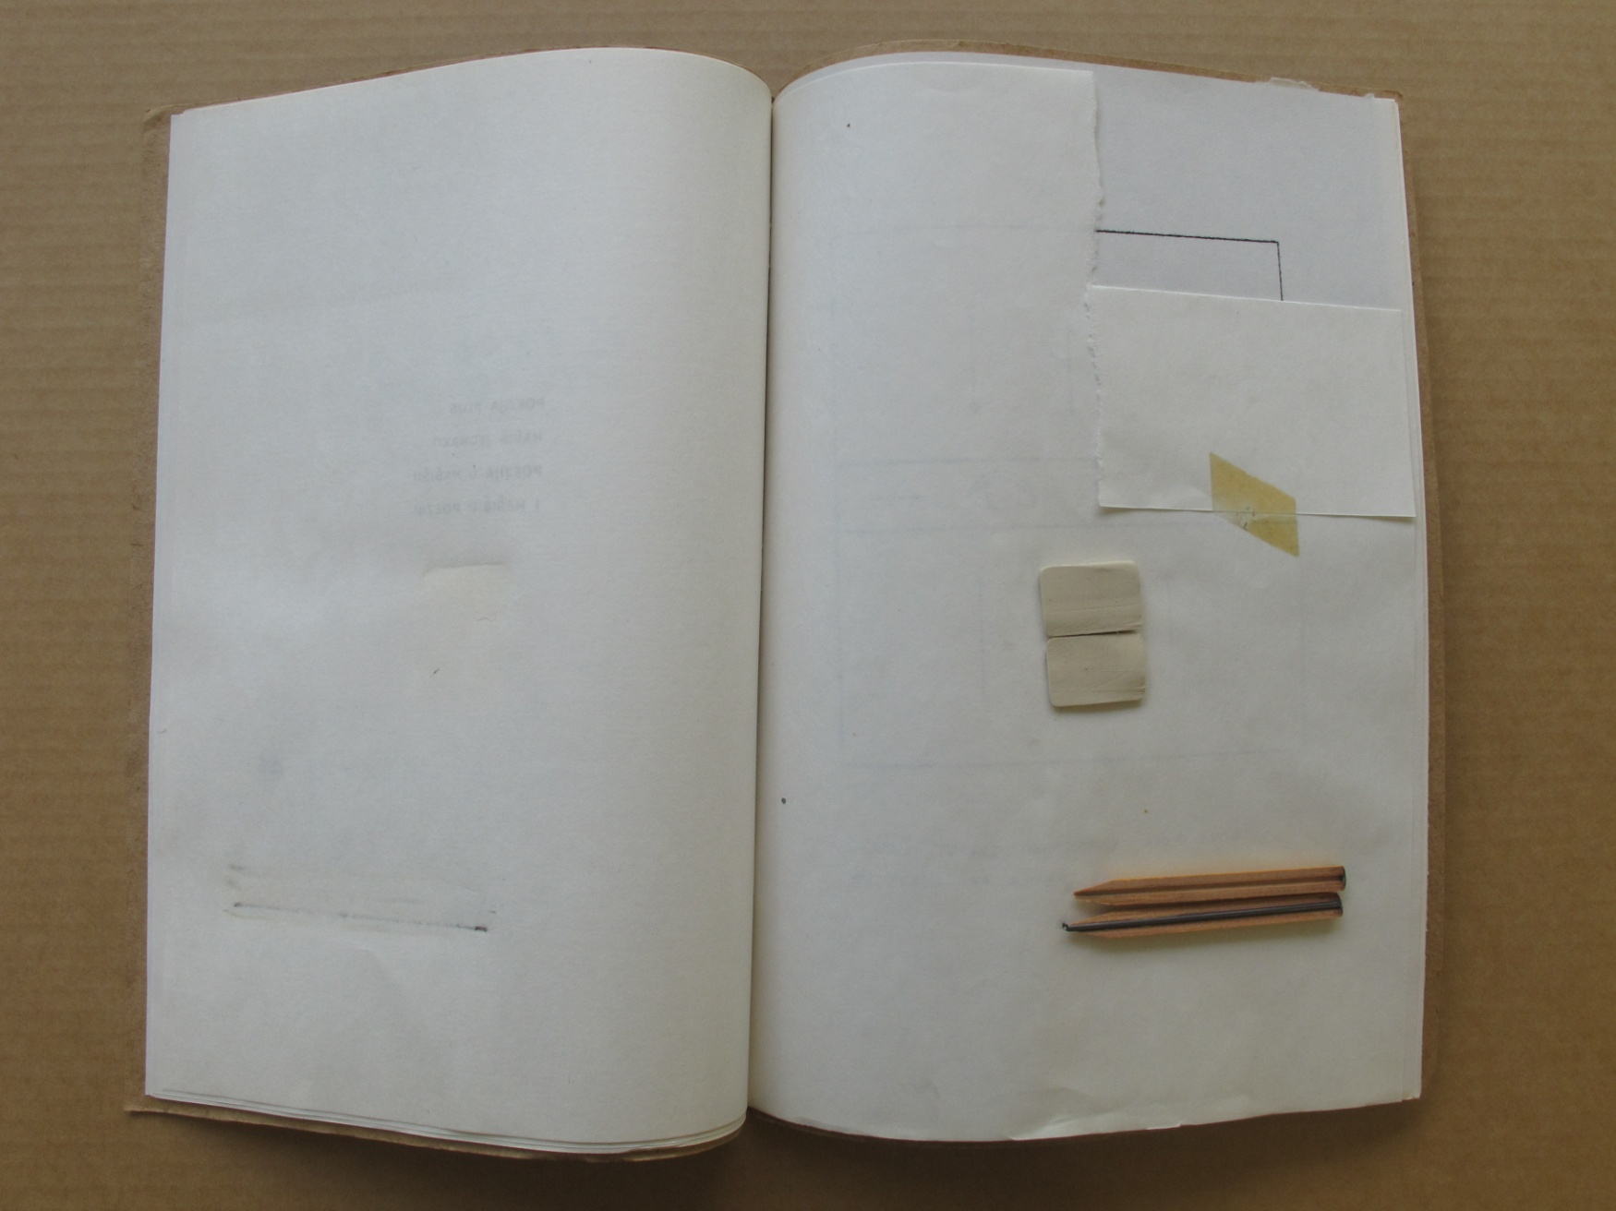
Maj 75

Slide 39
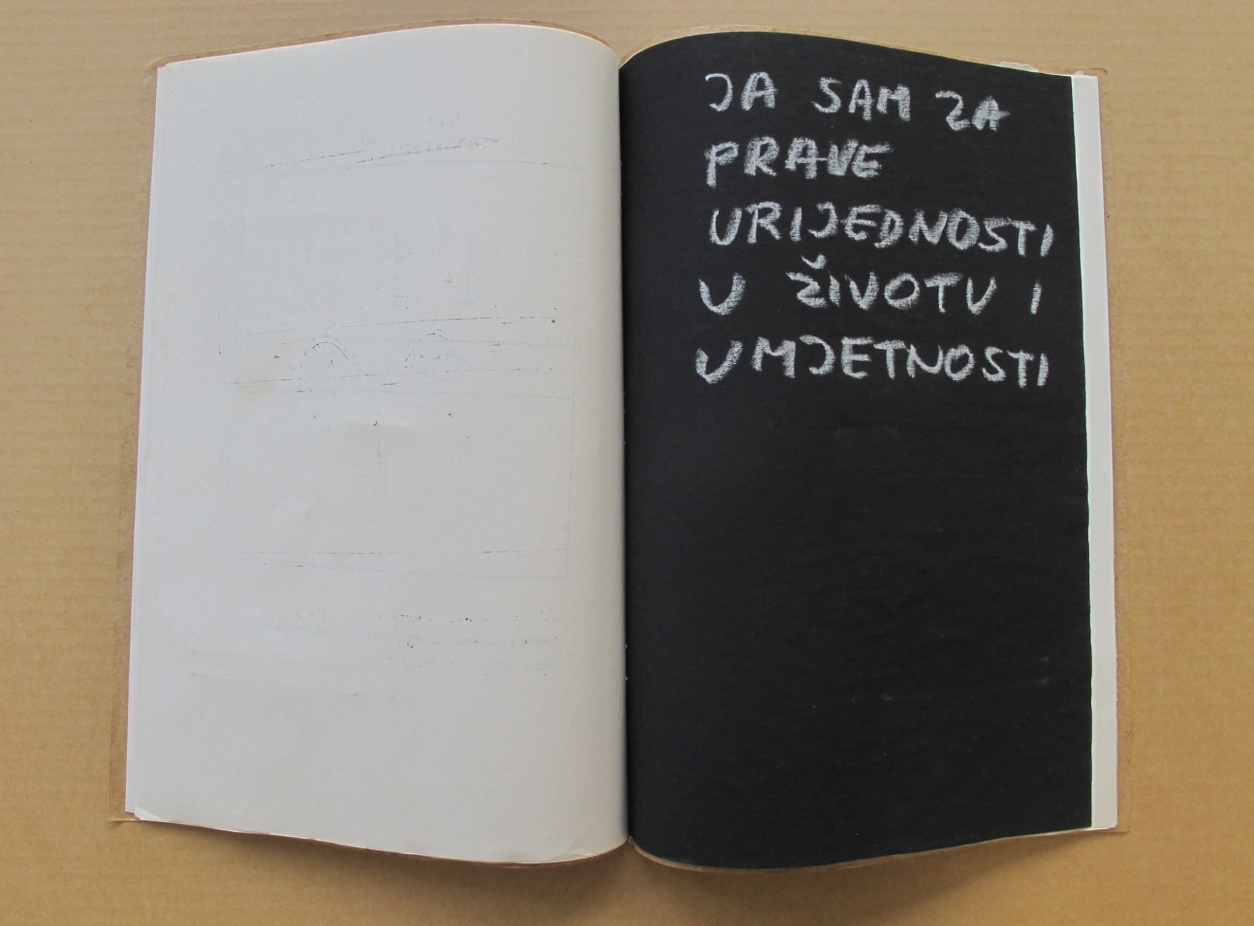
Maj 75

Slide 40
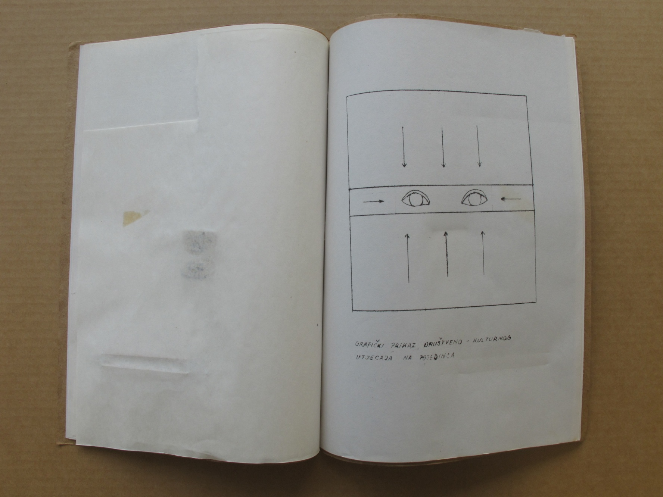
Maj 75

Slide 41
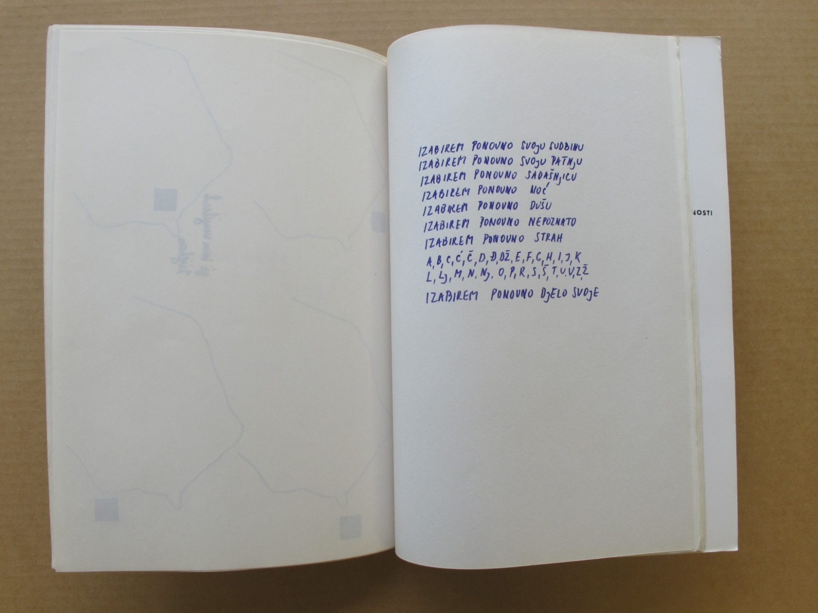
Maj 75

Slide 42
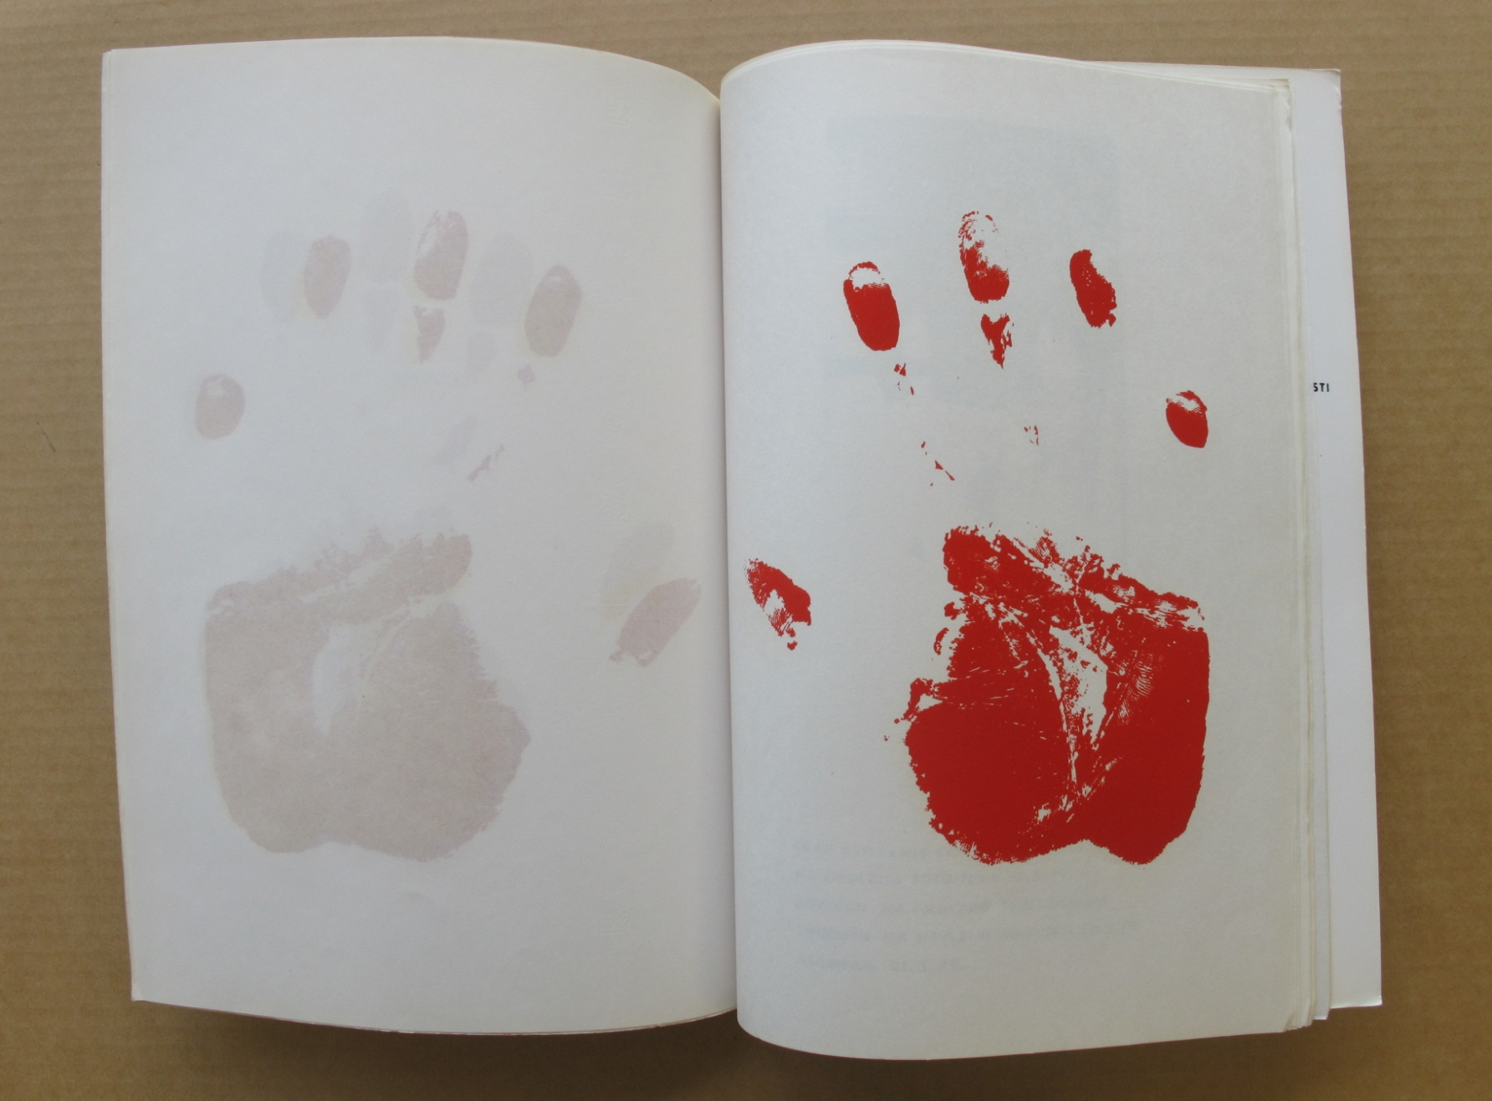
Maj 75

Slide 43
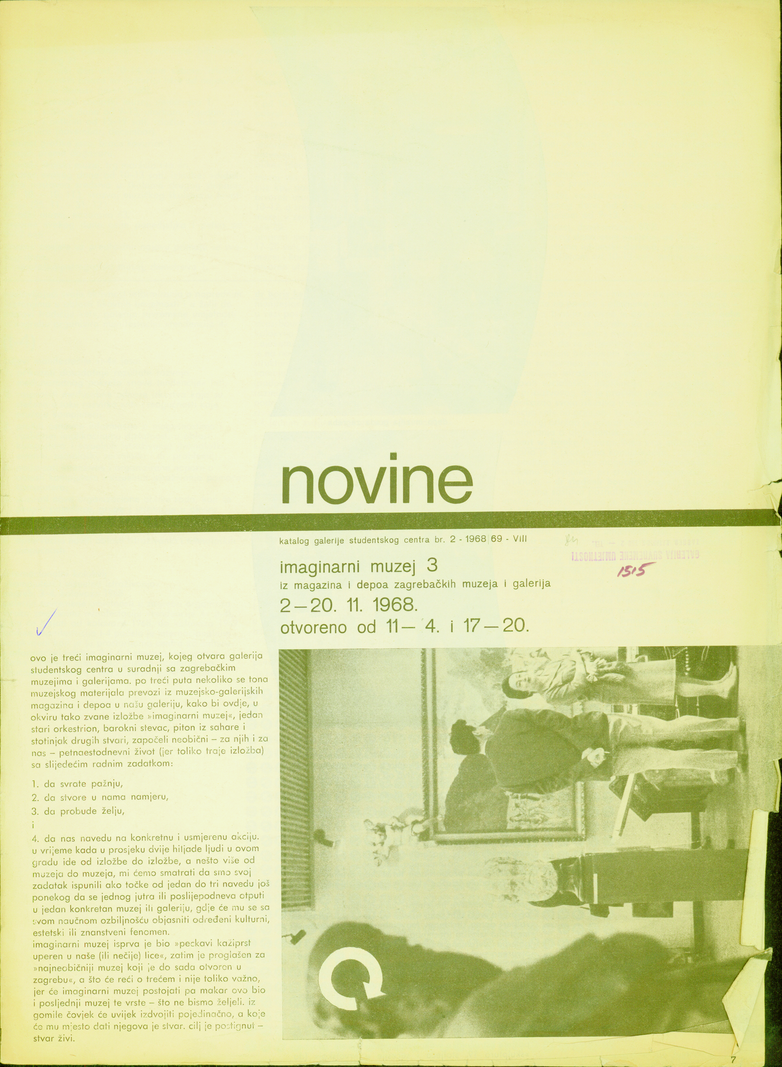
Novine Galerije SC

Slide 44
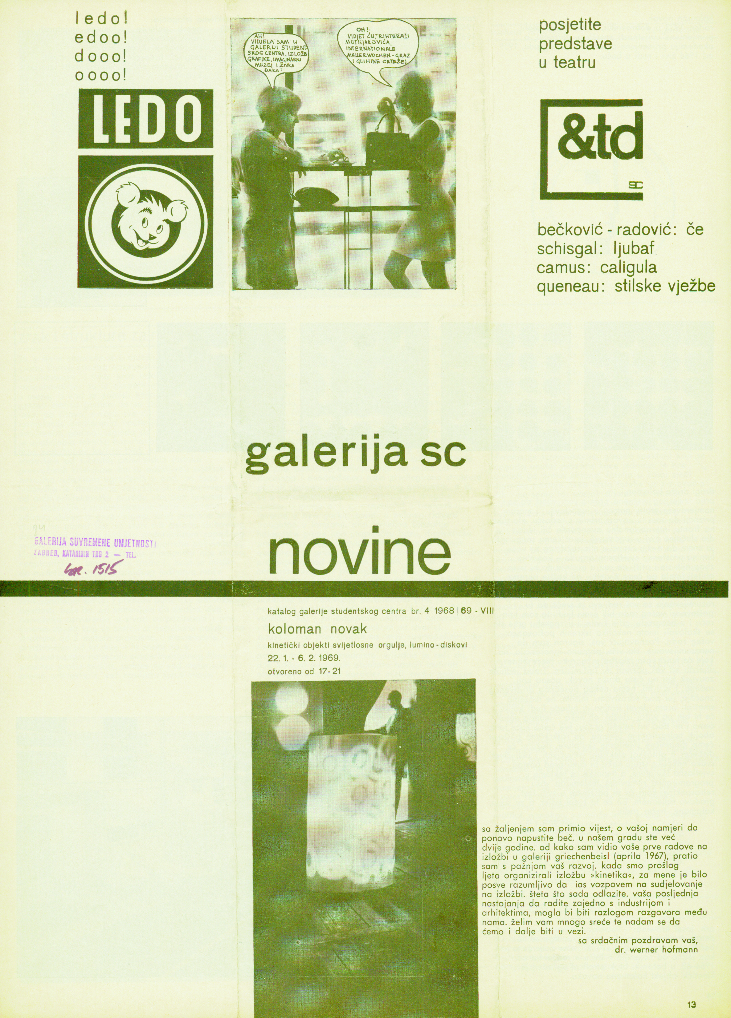
Novine Galerije SC

Slide 45
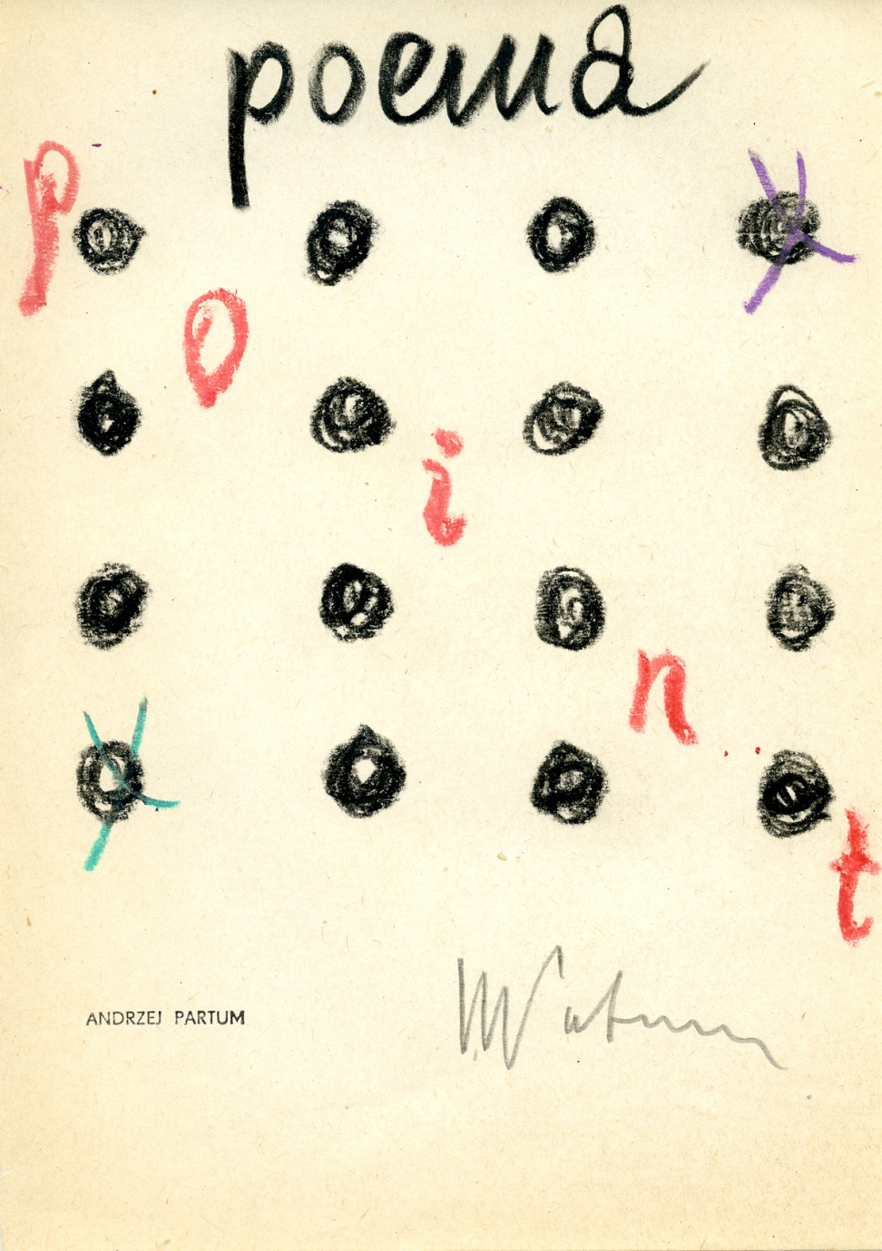
Andrzej Partum Arhiv

Slide 46

Andrzej Partum Arhiv

Slide 47
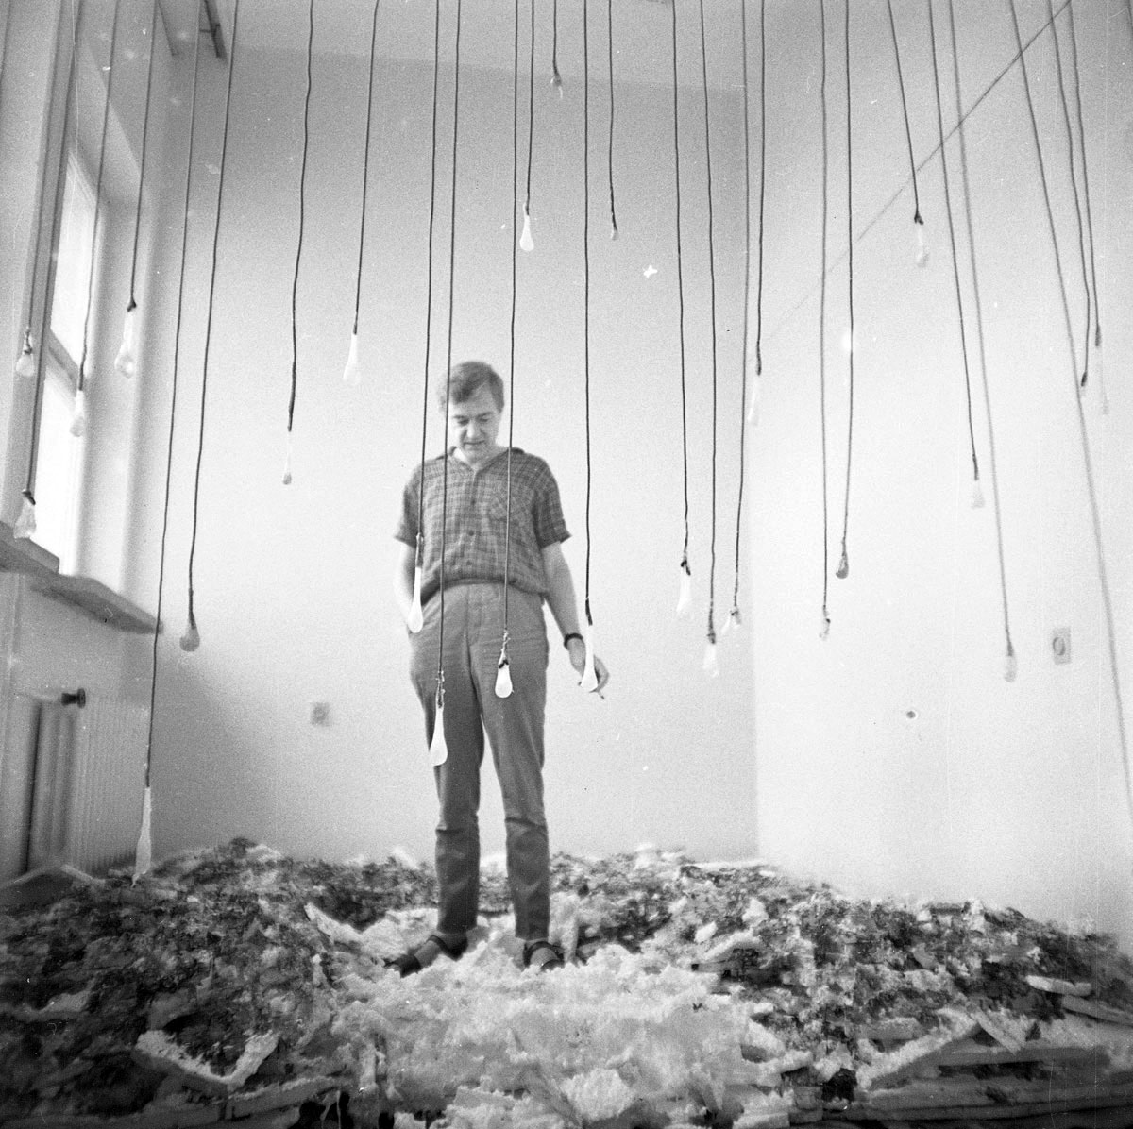
Eustachy Kossakowski Arhiv

Slide 48
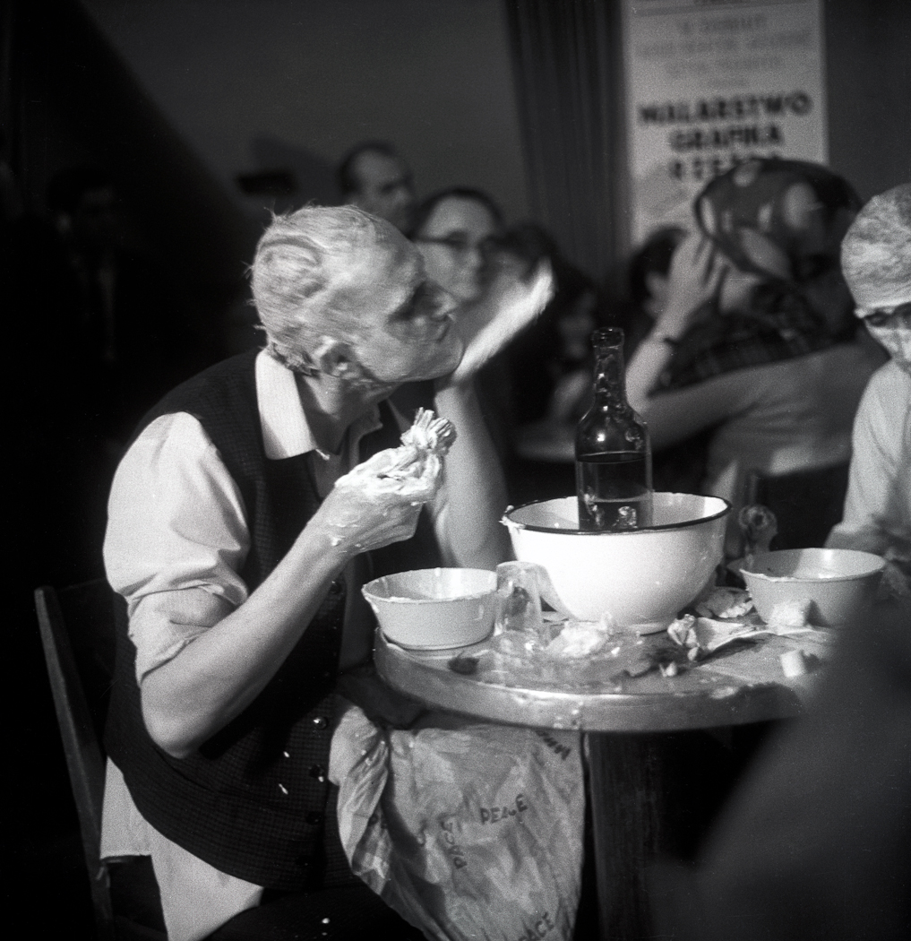
Eustachy Kossakowski Arhiv

Slide 49
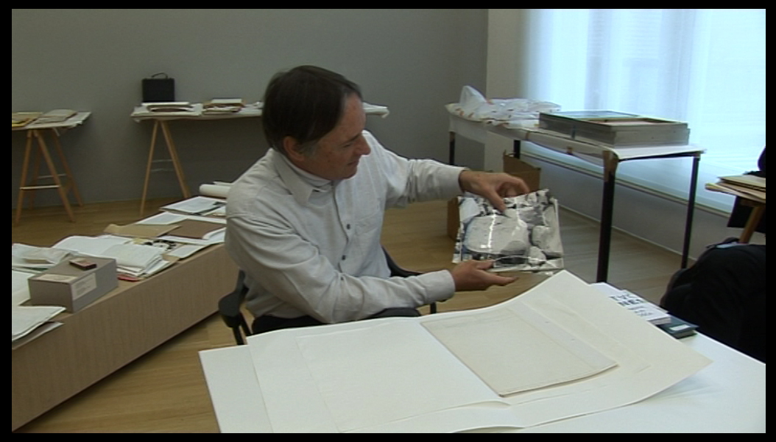
OHO Arhiv

Slide 50
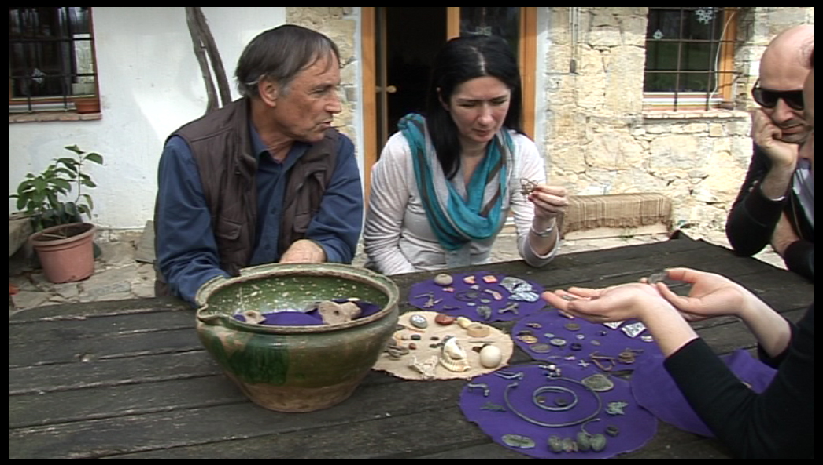
OHO Arhiv

Slide 51
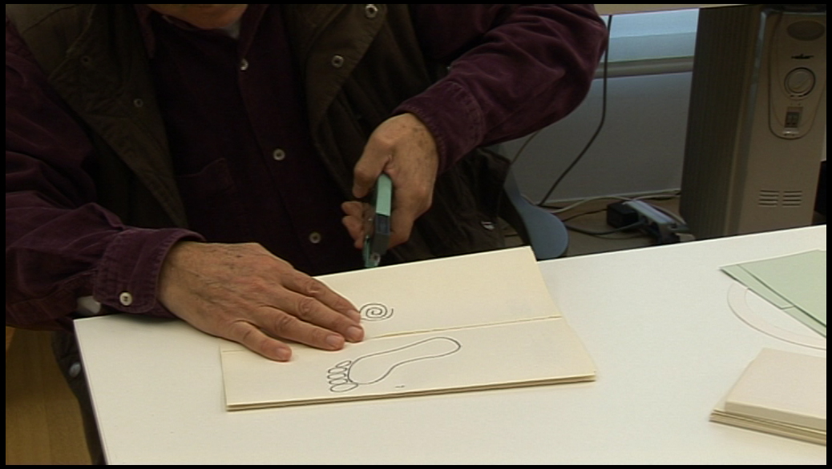
OHO Arhiv

Slide 52
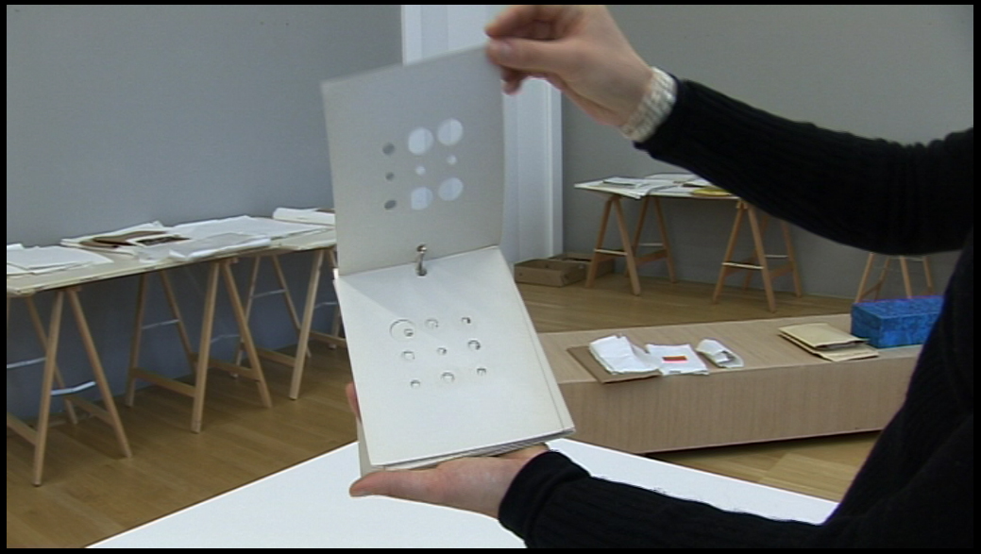
OHO Arhiv

Slide 53
THE GOAL OF THE PROJECT
An open-access internet portal- by publishing the works and documentation of conceptual and neo-avant-garde art in digital format, the project will enable international exchange among curators, museum professionals, artists and researchers.

Slide 54
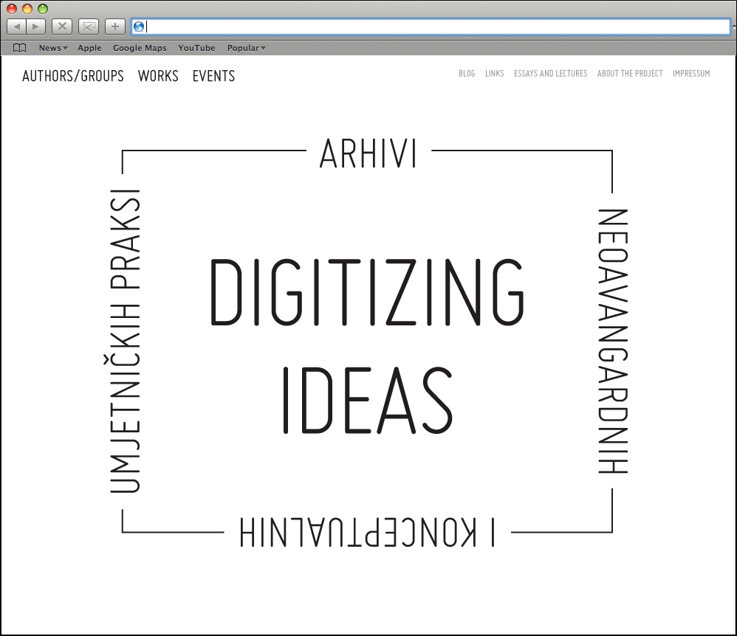

Slide 55
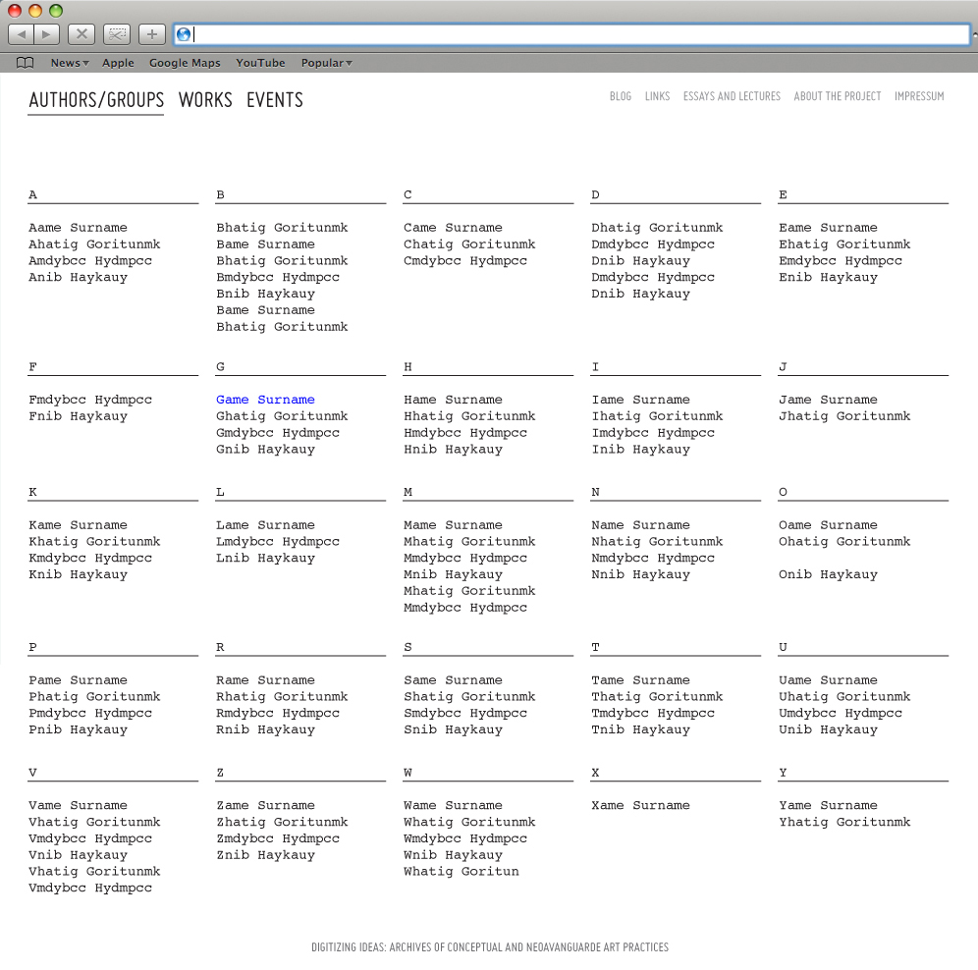

Slide 56
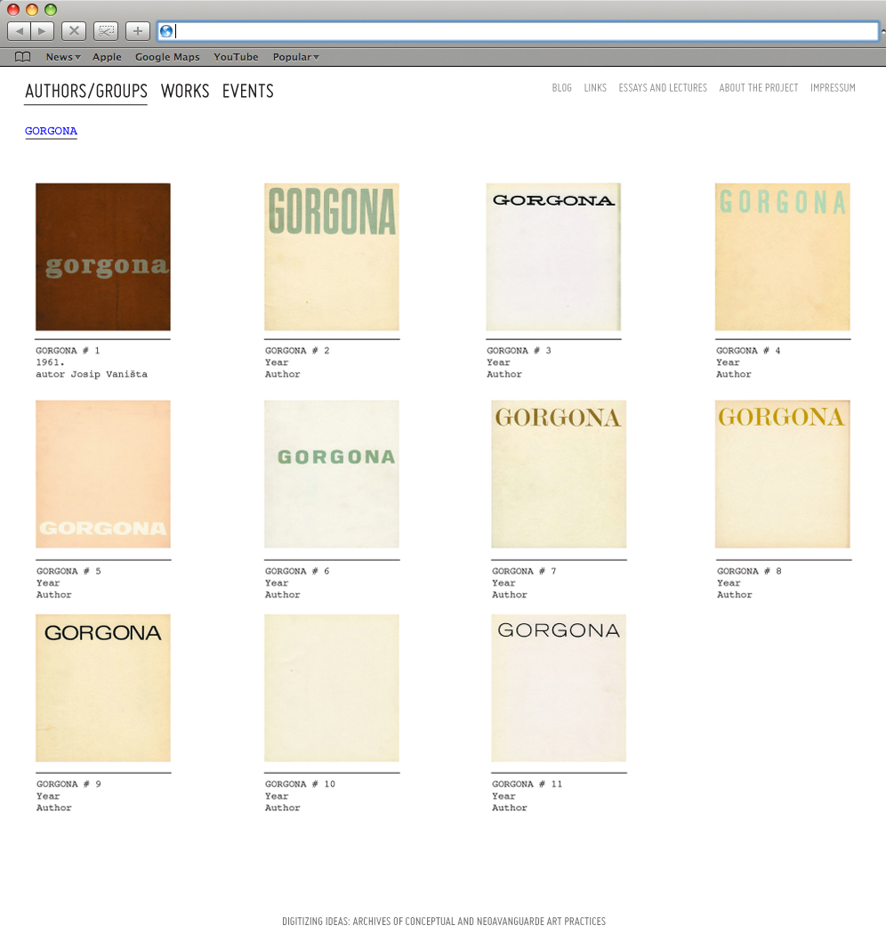

Slide 57
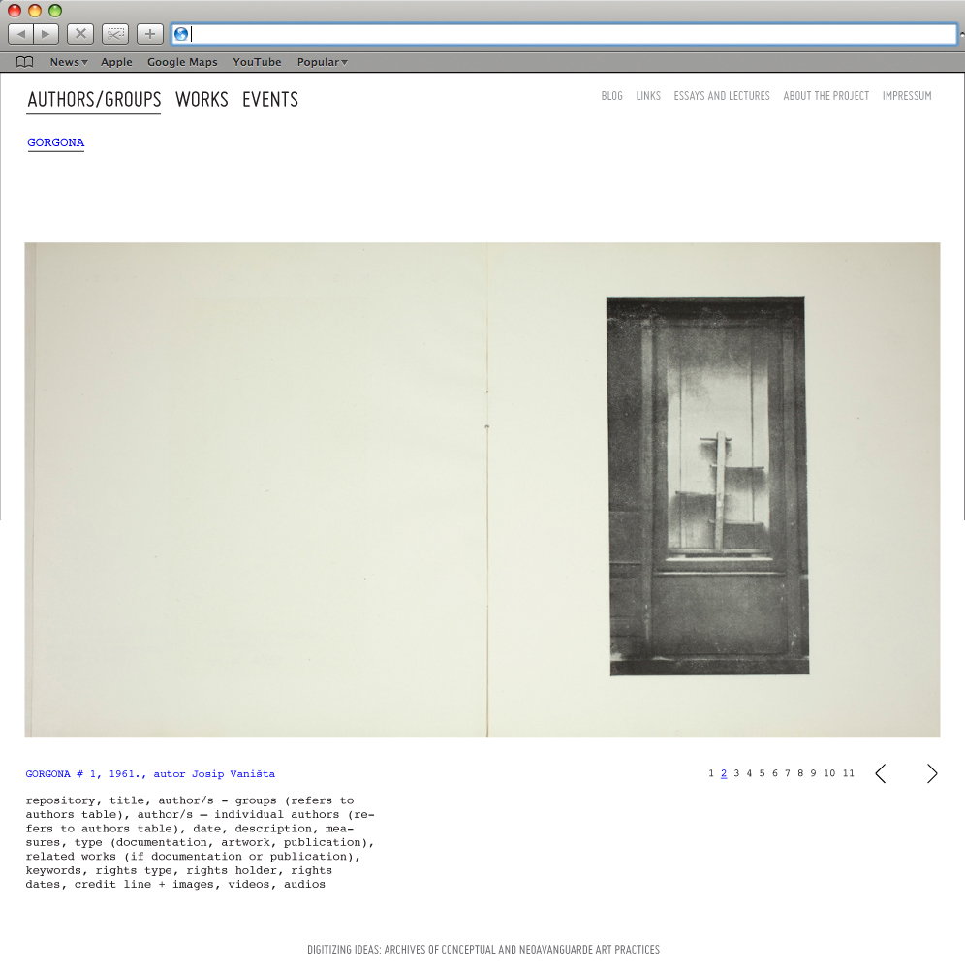

Slide 58
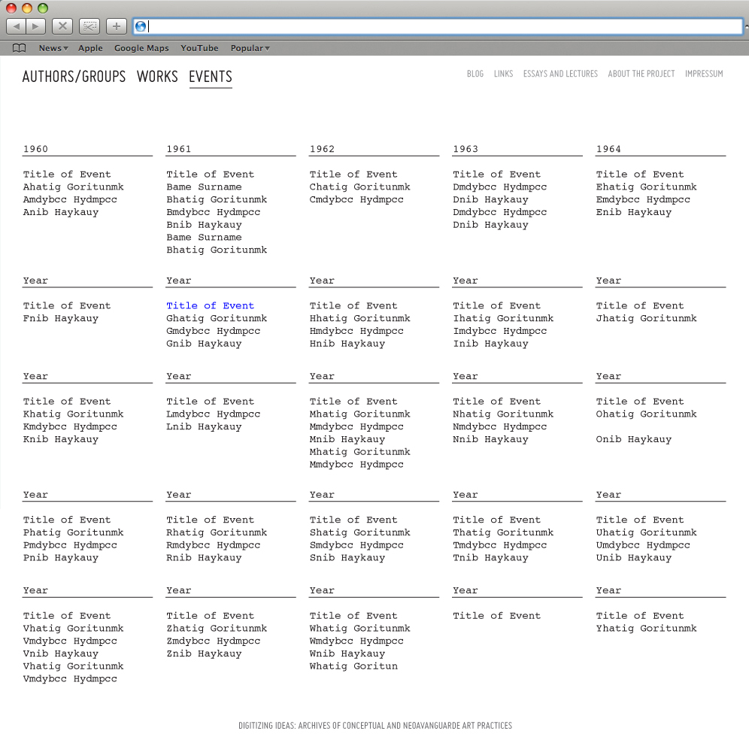

Slide 59
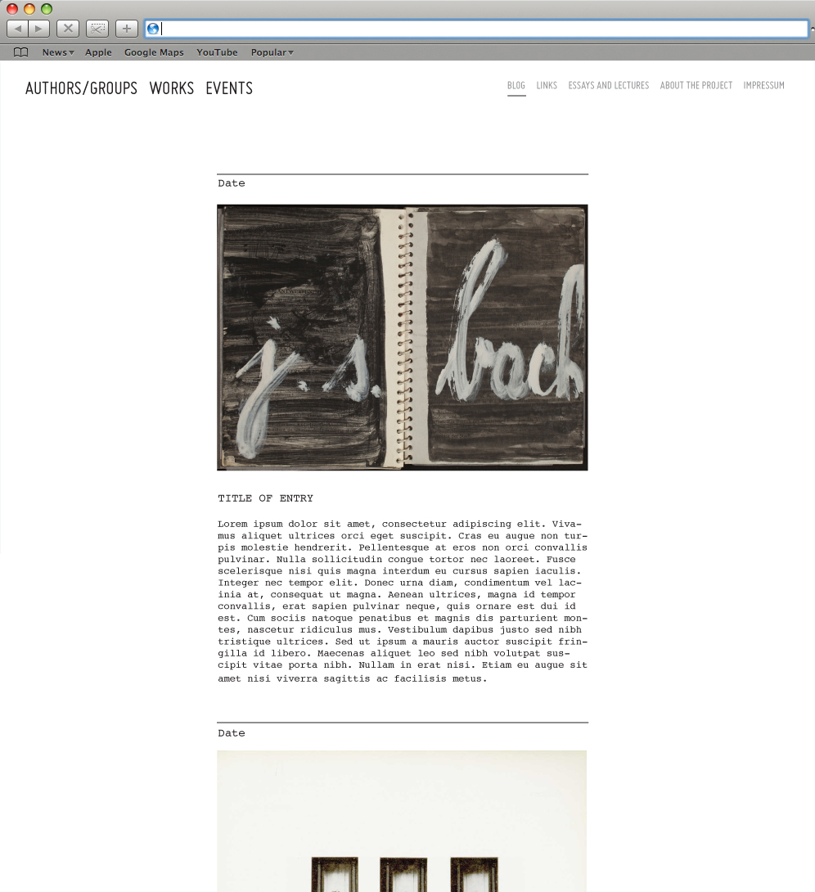

Slide 60
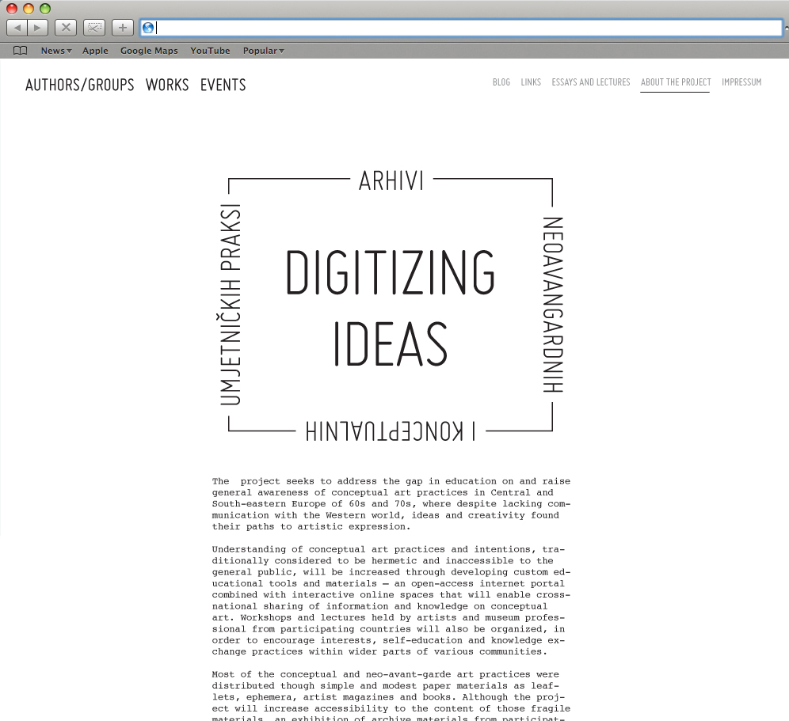

Slide 61
OUTCOMES and OUTPUTS

Slide 62
OUTCOME – Digitalization: Archives and museum collections of conceptual art published in an electronic format
OUTPUTS - 600 artworks of 100 artists and art groups, 500 catalogues, 10 personal archives, 10 group archives published; 5 electronic interfaces produced

Slide 63
THE PROJECT RESULTS:
a) the digital collection will remain available online
b) the university course will be included into the offer of university programs for art history students

Slide 64
NEW TENDENCIES EXHIBITION

Slide 65
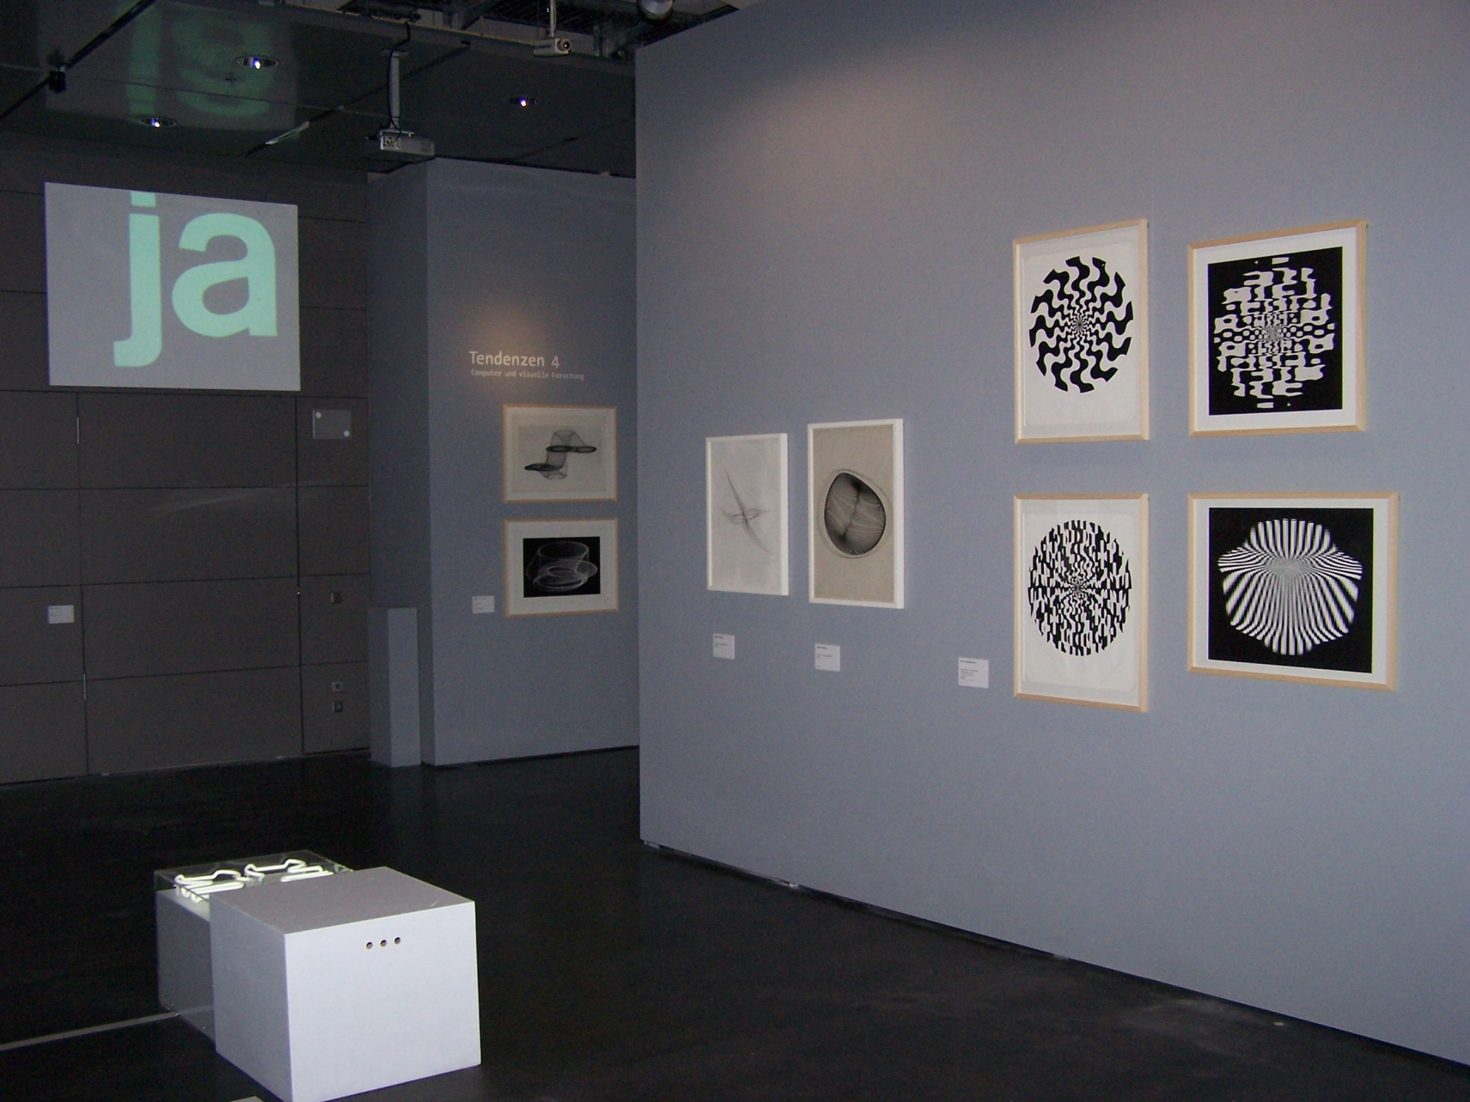
“bit international. [Nove] tendencije Computer und visuelle Forschung
Zagreb 1961-1973” ZKM - Zentrum für Kunst und Medientechnologie Karlsruhe
23.02.2008-18.01.2009

Slide 66
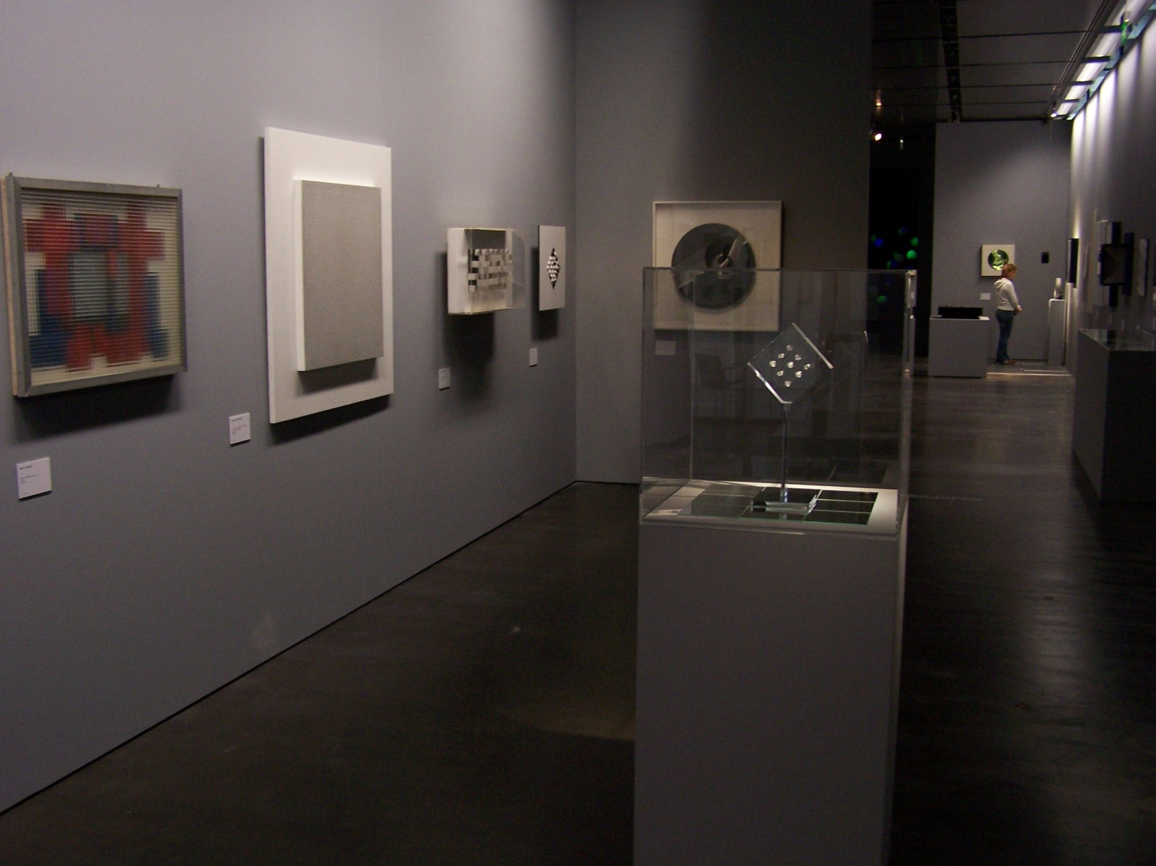
“bit international. [Nove] tendencije Computer und visuelle Forschung
Zagreb 1961-1973” ZKM - Zentrum für Kunst und Medientechnologie Karlsruhe
23.02.2008-18.01.2009

Slide 67
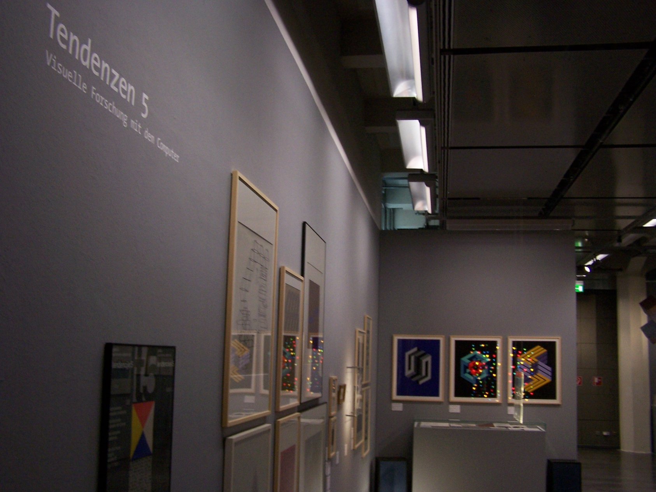
“bit international. [Nove] tendencije Computer und visuelle Forschung
Zagreb 1961-1973” ZKM - Zentrum für Kunst und Medientechnologie Karlsruhe
23.02.2008-18.01.2009

Slide 68
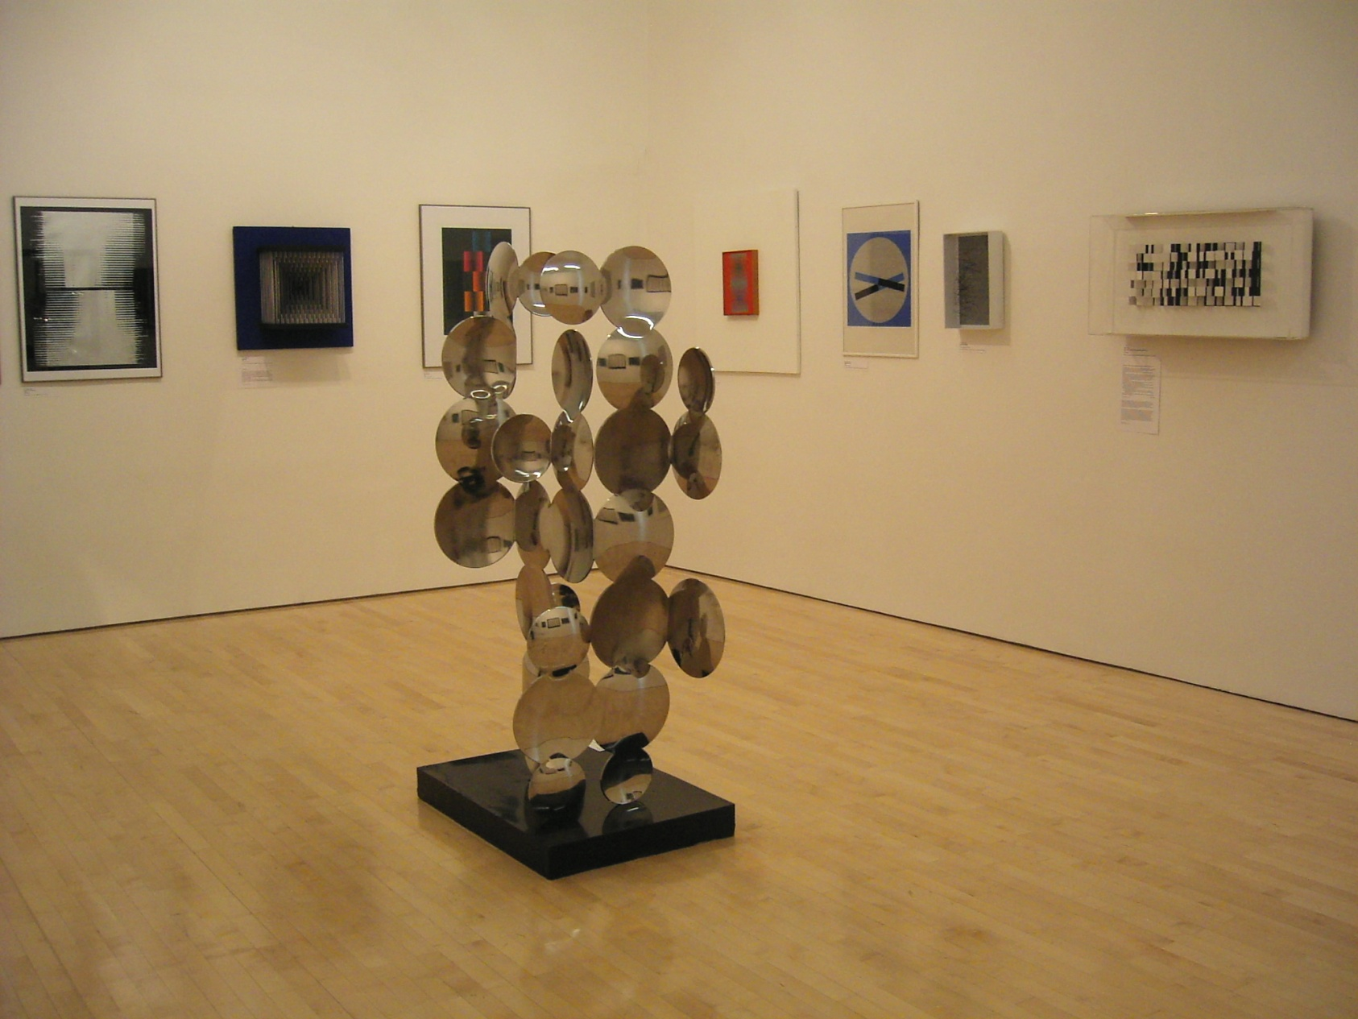
„bit international. [Nove] tendendcije – Computer und visuelle Forschung. Zagreb 1961-1973“ Neue Galerie Graz
28.04.-17.06.2007

Slide 69

„bit international. [Nove] tendendcije – Computer und visuelle Forschung. Zagreb 1961-1973“ Neue Galerie Graz
28.04.-17.06.2007

Slide 70

„bit international. [Nove] tendendcije – Computer und visuelle Forschung. Zagreb 1961-1973“ Neue Galerie Graz
28.04.-17.06.2007

Slide 71

Nove tendencije 3, kolokvij u Brezovici 1965.

Slide 72

Nove tendencije 3, kolokvij u Brezovici 1965.

Slide 73

magazine Bit: international, No. 1, 1968.

Slide 74

magazine Bit: international, No. 7, 1972.

Slide 75
MSU’S AUDIO-VISUAL STUDIO

